Slide 1

Lecture 1 Database Systems: An Introduction
Jihong Guan
Email: jhguan@tongji.edu.cn
Department of Computer Science and Technology
Tongji University

Slide 2
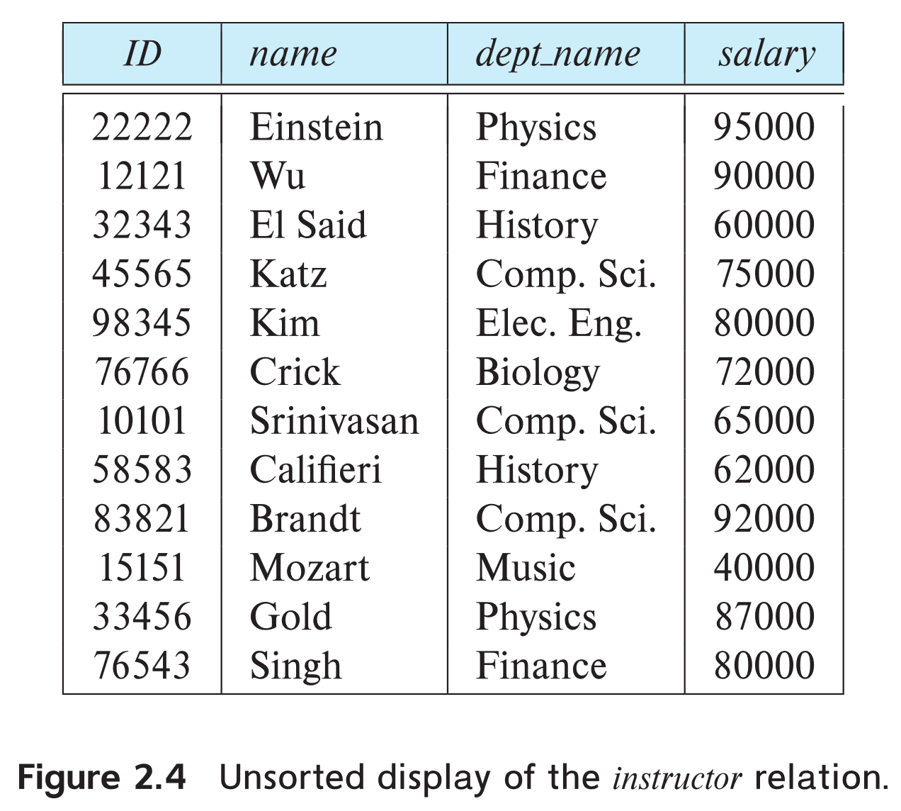
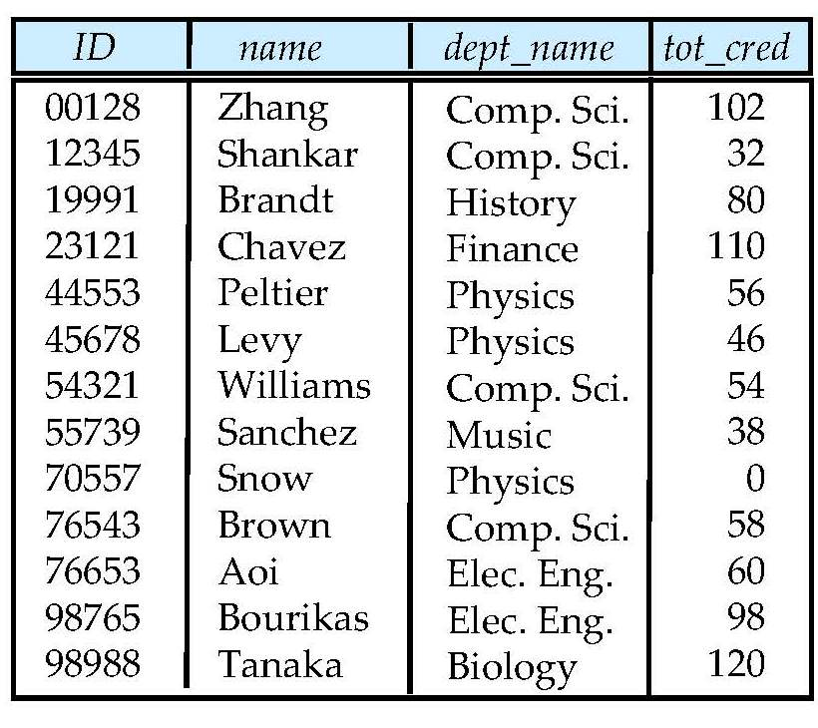
University Database
Instructor table
Student table

Slide 3
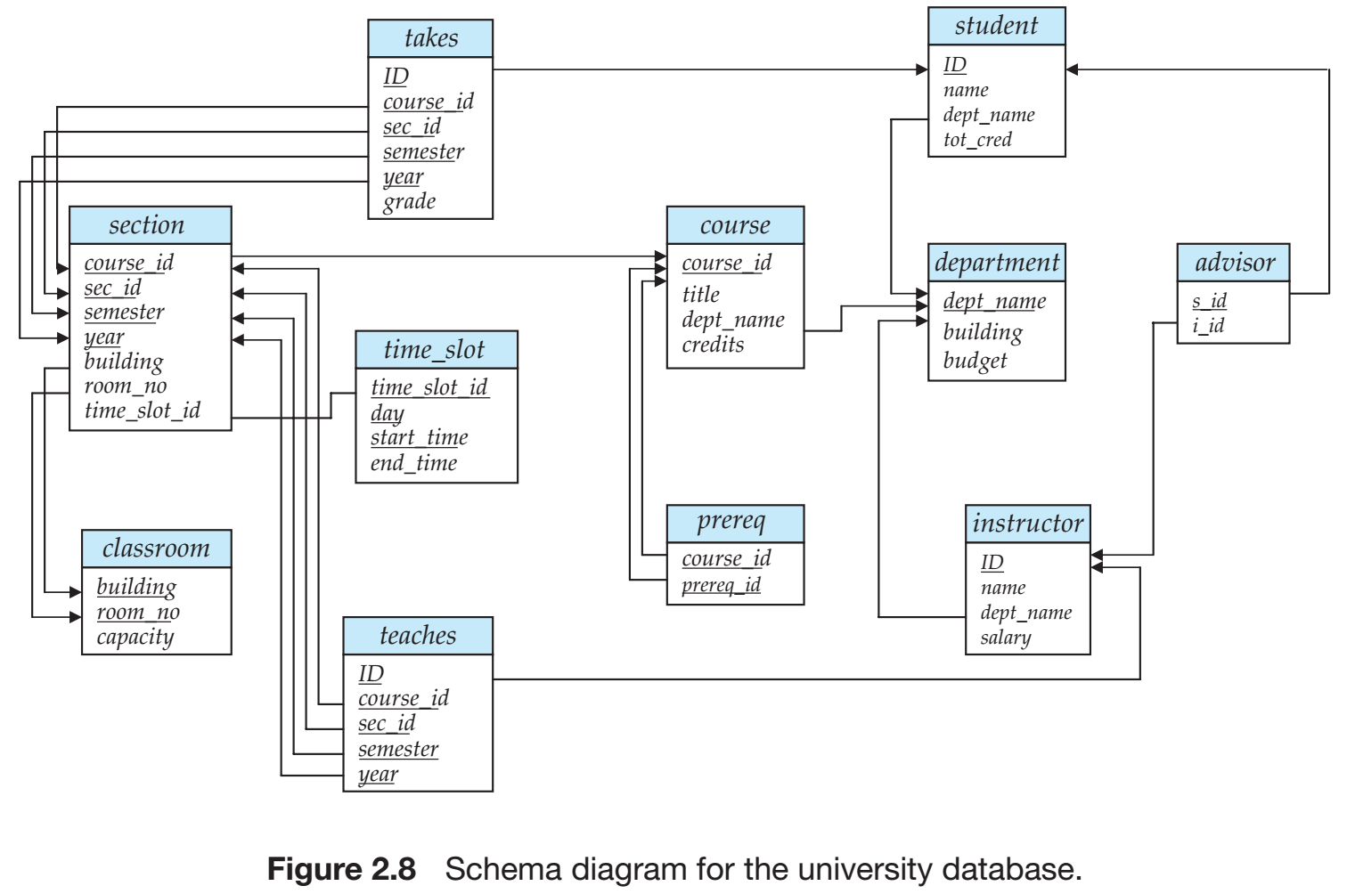
University Database
Relational Model
SQL
Database Design
Storage & Query
Transactions

Slide 4
Outline of the Course
☞ Part 0: Overview
Ch1: Introduction
Part 1 Relational Databases
Ch2: Relational model (data model, relational algebra)
Ch3&4: SQL(Structured Query Language)
Ch5: Advanced SQL
Part 2 Database Design
Ch6: Database design based on E-R model
Ch7: Relational database design
Part 3 Application Design & Development
Ch8: Complex data types
Ch9: Application development
Part 4 Big data analytics
Ch10: Big data
Ch11: Data analytics
Part 5 Data Storage & Indexing
Ch12: Physical storage system
Ch13: Data storage structure
Ch14: Indexing
Part 6 Query Processing & Optimization
Ch15: Query processing
Ch16: Query optimization
Part 7 Transaction Management
Ch17: Transactions
Ch18: Concurrency control
Ch19: Recovery system
Part 8 Parallel & Distributed Database
Ch20: Database system architecture
Ch21-23: Parallel & distributed storage, query processing & transaction processing
Part 9
DB Platform:OceanBase, MongoDB, Neo4J

Slide 5
Outline
☞ Database system
Data view
DB languages
DB design
DB engine
Database architecture
DB user and administrator
History of DB
Future directions

Slide 6
What Is a Database
An integrated collection of data
The data is structured and interrelated
The data is integrated
Model real-world enterprises or organizations
Entities (e.g., students, courses)
Relationships (e.g. Li is taking Database and OS )
Databases touch various aspects of our lives
People interact with database from indirect way (printed report) to direct way (teller machine)

Slide 7
Database Applications
Various applications
Banking: all transactions
Airlines: reservations, schedules
Universities: registration, grades, students
Sales: customers, products, purchases
Online retailers: order tracking, customized recommendations
Manufacturing: production, inventory, orders, supply chain
Human resources: employee records, salaries, tax deductions
……

Slide 8
Example: University Database
Application scenarios
Add new students, instructors and courses
Register students for courses, and generate class rosters（名单）
Assign grades to students, calculate grade point averages (GPA) and generate transcripts
In the early days, database applications were built directly on top of file systems

Slide 9
Drawbacks of using File Systems to Store Data
Data redundancy(冗余) and inconsistency(不一致)
Multiple file formats (different programmers/languages/structures), duplication of information in different files
Difficulty in accessing data
Need to write a new program to carry out each new task
Data isolation(隔离)
Multiple files and formats
Integrity(完整性) problems
Integrity constraints (e.g., account balance > 0) become “buried” in program code rather than being stated explicitly
Hard to add new constraints or change existing ones

Slide 10
Drawbacks of using File Systems to Store Data
Atomicity(原子性) of updates
Failures may leave database in an inconsistent state with partial updates carried out
E.g., transfer of funds from one account to another should either complete or not happen at all
Concurrent access(并发访问) by multiple users
Concurrent access needed for better performance
Uncontrolled concurrent accesses can lead to inconsistencies
E.g., two people reading a balance (say 100) and updating it by withdrawing money (say 50 each) at the same time
Security(安全) problems
Hard to provide user access to some, but not all, data
Notes:
Database systems offer solutions to all the above problems

Slide 11
Database Management System (DBMS)
DBMS
A software package designed to store and manage databases
Functions of DBMS
Manages a large amount of data
Supports efficient and concurrent access to a large amount of data
Supports secure, atomic access to a large amount of data: two people editing the same file – last to write “wins”
Advantages of DBMS
Data independence and efficient access
Reduce application development time
Data integrity and security
Uniform data administration
Concurrent access
Recovery from crashes

Slide 12
Is a File System a DBMS?
Experiment 1:
You and your partner are editing the same file.
You both save it at the same time.
Whose changes survive?
Experiment 2:
You’re updating a file.
The power goes out.
Which of your changes cannot survive?
A) Yours
B) Partner’s
C) Both
D) Neither
E) ???
A) All
B) None
C) All since last save
D) ???

Slide 13
Is a Traditional IR System a DBMS?
Traditional IR (Information Retrieval 信息检索) system
Mainly for data retrieval, not data update
Store/manage free structured or semi-structured document
Support semantic-oriented matching (语义匹配)
Consider no data consistency, and concurrency is easy to be implemented
DBMS
Support data access and update
Store and manage structured data (RDBMS)
Require declarative（陈述性）query language support
Support data consistency, atomic transaction, concurrency control and failure recovery

Slide 14
Is Web Search Engine a DBMS?
Keyword-based search for pages
Data is mostly unstructured and untyped
Search only
can’t modify the data
can’t get summaries（概括）, complex combinations of data
Few guarantees provided for freshness of data, consistency across data items, fault tolerance, etc.
Web sites (e.g., e-commerce 电子商务) typically have a DBMS in the backend to provide these functions

Slide 15
Database Systems
A Database System (DBS) contains the following components
Hardware platform (PC, Workstation, Cluster, Mainframe, etc.)
DBMS
A (number of) database(s)
Human interface that is both convenient and efficient to use

Slide 16
Outline
Database system
☞ Data view
DB languages
DB design
DB engine
Database architecture
DB user and administrator
History of DB
Future directions

Slide 17
Data Abstraction
Real Word
Abstraction
Real world Conceptual model
Database Designers
Information world
Conceptual Model
Conceptual model Logical model
Database Designers
Data model supported
by DBMS
Machine world
Logical model Physical model
DBMS

Slide 18
Levels of Abstraction
Physical level
Describe how a record is stored on storage devices.
Logical level
Describe what data stored in database, and the relationships among the data.
Although implementation of the simple structures at the logical level may involve complex physical-level structures, the user of the logical level does not need to be aware of this complexity. This is referred to as physical data independence.
type customer = record
customer_id : string; customer_name : string; customer_street : string; customer_city : integer;
end;
View level
Many users of the database system do not need all this information; instead, they need to access only a part of the database. The view level of abstraction simplifies their interaction with the system.
Views can also hide information (such as an employee’s salary) for security purposes.

Slide 19
View of Data
View Level
View 1
View 2
View n
…
Logical level
Physical level

Slide 20
Instances and Schemas
Similar to variables and types in programming languages
Schema(模式): the logical structure of the database
E.g., the database consists of information about a set of customers and accounts, and the relationship between them
Analogous to type information of a variable in a program
Physical schema(物理模式): database design at the physical level
Logical schema(逻辑模式): database design at the logical level
External schema(外模式): user defined schema at the app level
Instance(实例): the actual content of the database at a particular point of time, analogous to the value of a variable

Slide 21
Instances and Schemas
Schema – the logical structure of the database
Physical schema: internal schema, storage schema
Logical schema: schema
External schema: user’s schema, subschema
Physical data independence – the ability to modify the physical schema without changing the logical schema
In general, the interfaces between the various levels and components should be well defined so that changes in some parts do not seriously influence others
Logical data independence – the ability to modify the logical schema without changing the external schema

Slide 22
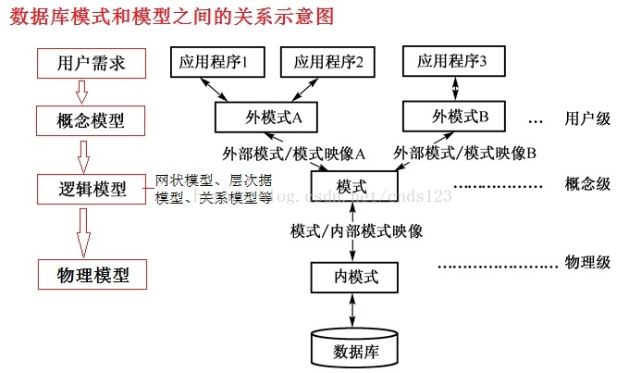
Data Models and Schemas

Slide 23
Data Models
A collection of tools for describing data structures, data relationships, data semantics, and data constraints
Relational model
Tables as relations to represent data and their relationships
Record-based model
Entity-Relationship data model (mainly for database design)
Entity-relationship (E-R) data model
Object-based data models (Object-oriented/Object-relational)
Extending the E-R model with notions of encapsulation, methods(functions), and object identity
Semi-structured data model (JSON, XML)
Other older models:
Network model (e.g. Honeywell IDS)
Hierarchical model (e.g. IBM IMS)

Slide 24
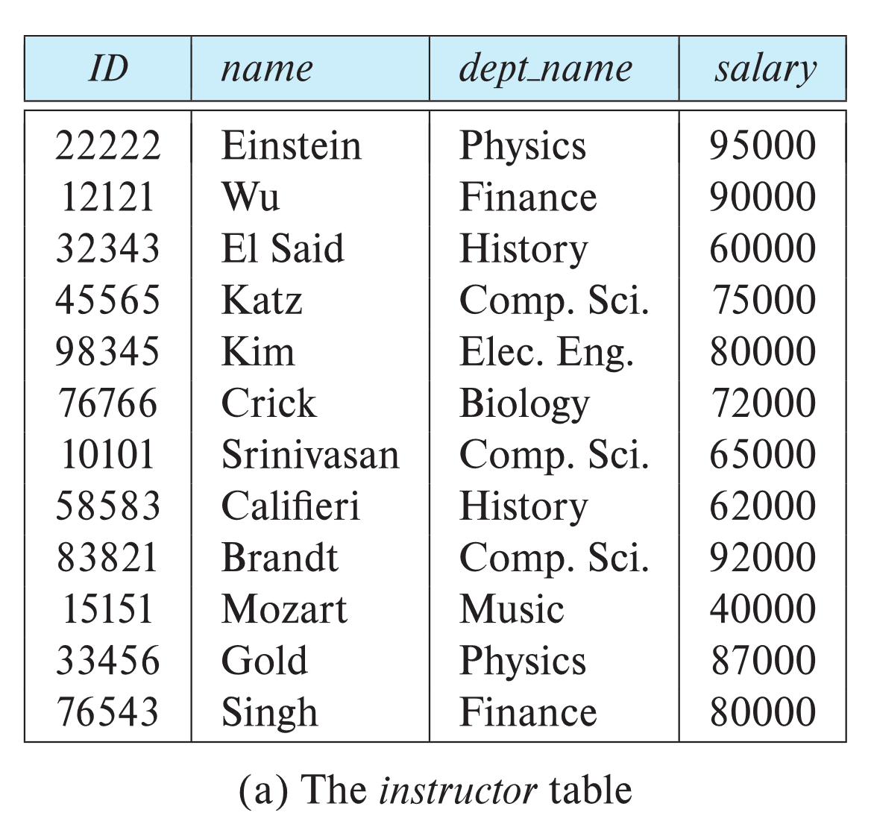
Relational Model
Example of tabular data in the relational model
Columns
Rows
Notes:
Delimit:限定

Slide 25
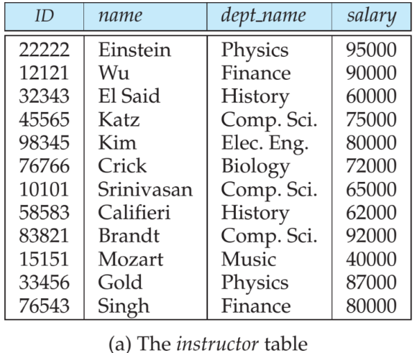
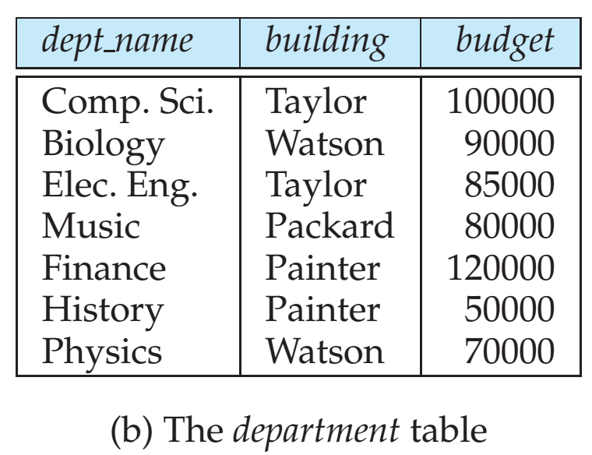
A Sample of Relational Database

Slide 26
Object-Relational Data Models
Extend the relational data model by including
Inheritance (继承)/ encapsulation (封装) /methods(functions) /object identity
Allow attributes of tuples to have complex types, including non-atomic values such as nested relations
Preserve relational foundations, in particular the declarative access to data, while extending modeling power
Provide upward compatibility (向上兼容) with existing relational languages

Slide 27
XML: eXtensible Markup Language
Defined by WWW Consortium (W3C, 万维网联盟)
Originally intended as a document markup language not a database language
The ability to specify new tags, and to create nested tag structures made XML a great way to exchange data, not just documents
XML has become the basis for various data interchange formats
A wide variety of tools is available for parsing, browsing and querying XML documents/data
Notes:
XML是 1.11.2 半结构化数据类型的代表
The World Wide Web Consortium (W3C) is an international community where Member organizations, a full-time staff, and the public work together to develop Web standards. Led by Web inventor and Director Tim Berners-Lee and CEO Jeffrey Jaffe, W3C's mission is to lead the Web to its full potential.
data interchange: 数据交互

Slide 28
XML: An Example
<?xml version="1.0" encoding="UTF-8" standalone="yes"?>
<CDLIST>
<CD artist="Yung Jo Yee, Joey">
<TITLE>Ten Most Wanted</TITLE>
<RELEASE>Feb 26, 2006</RELEASE>
<PRICE>$20</PRICE>
</CD>
<CD artist="Twins">
<TITLE>The Missing Piece</TITLE>
<RELEASE>Feb 20, 2006</RELEASE>
<PRICE>$10</PRICE>
</CD>
<CD artist="Twins">
<TITLE>2006 Concert Live</TITLE>
<RELEASE>Feb 20, 2006</RELEASE>
<PRICE>$10</PRICE>
</CD>
<CD artist="Justin">
<TITLE>No Protection</TITLE>
<RELEASE>March 24, 2006</RELEASE>
<PRICE>$15</PRICE>
</CD>
</CDLIST>
Info about one CD

Slide 29
Outline
Database system
Data view
☞ DB languages
DB design
DB engine
Database architecture
DB user and administrator
History of DB
Future directions

Slide 30
Database Language
A database system provides a data-definition language(DDL) to specify the database schema and a data-manipulation language (DML) to express database queries and updates.
Data-definition language(DDL, 数据定义语言)
Specify the database schema
SQL provides a rich DDL that allows one to define tables, integrity constraints, assertions, etc.
Data-manipulation language(DML, 数据操纵语言)
Express database queries and updates

Slide 31
Data Definition Language (DDL)
Defining the database schema
Example: create table department ( dept_name char(20), building char(15)
budget numeric(12,2));
DDL compiler generates a set of tables stored in a data dictionary
Data dictionary contains metadata (i.e., data about data)
Database schema
Data storage and definition language
Specifies the storage structure and access methods
Consistency constraints
Domain constraints
Referential integrity (references constraint in SQL)
Assertions
Authorization
Notes:
The data dictionary is considered to be a special type of table that can only be accessed and updated by the database system itself (not a regular user). The database system consults the data dictionary before reading or modifying actual data.
Domain constraints: account balance of a department must never be negative Referential integrity :the dept name value in a course record must appear in the dept name attribute of some record of the department relation.
Assertions: Domain constraints and referential-integrity constraints are special forms of assertions. However, there are many constraints that we cannot express by using only these special forms. For example, “Every department must have at least five courses offered every semester” must be expressed as an assertion. Authorization :read/insert/update/delete

Slide 32
Data Manipulation Language (DML)
DML is for accessing and manipulating the data organized by the appropriate data model
DML also known as query language
Retrieval/ Insertion/ Deletion/ Modification
Two classes of languages
Procedural – user specifies what data is required and how to get those data
Nonprocedural (Declarative, 陈述性) – user specifies what data is required without specifying how to get those data
SQL is the most widely used non-procedural query language

Slide 33
SQL(Structured Query Language)
SQL: widely used non-procedural language
E.g., find all instructors in the department of History select instructor.name from instructor where instructor.dept_name = ‘History’
E.g., find the IDs of all instructors from those departments with a budget larger than 95000 select instructor.ID from instructor, department where instructor.dept_name = department.dept_name and department.budget > 95000
Application programs generally access databases through one of
Language extensions to allow embedded SQL
Application program interface (e.g., ODBC/JDBC) which allow SQL queries to be sent to a database

Slide 34
Outline
Database system
Data view
DB languages
☞ DB design
DB engine
Database architecture
DB user and administrator
History of DB
Future directions

Slide 35
Database Design
The process of designing the structure of the database:
Conceptual design –Decide what should be covered and their relations
Logical design –Decide the database schema, find a “good” collection of relation schemas.
Business decision – What attributes should we record in the database?
Computer science decision – What relation schemas should we have and how should the attributes be distributed among the various relation schemas?
use the entity-relationship model
employ a set of algorithms (collectively known as normalization) that takes as input the set of all attributes and generates a set of tables
Physical design – Decide the physical layout of the database

Slide 36
Entity-Relationship Model
Model an enterprise as a collection of entities and relationships
Entity: a “thing” or “object” in the enterprise that is distinguishable from other objects
Described by a set of attributes
Relationship (diamond): an association among several entities

Slide 37
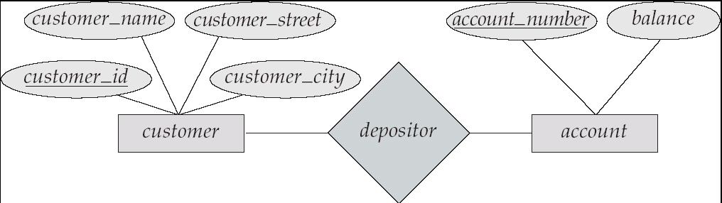
The Entity-Relationship Model
Represented diagrammatically by an entity-relationship diagram:

Slide 38

Relational Model
Example of tabular data in the relational model
Attributes
Customer-id
customer-name
customer-street
customer-city
account-number
192-83-7465
019-28-3746
192-83-7465
321-12-3123
019-28-3746
Johnson
Smith
Johnson
Jones
Smith
Alma
North
Alma
Main
North
Palo Alto
Rye
Palo Alto
Harrison
Rye
A-101
A-215
A-201
A-217
A-201

Slide 39
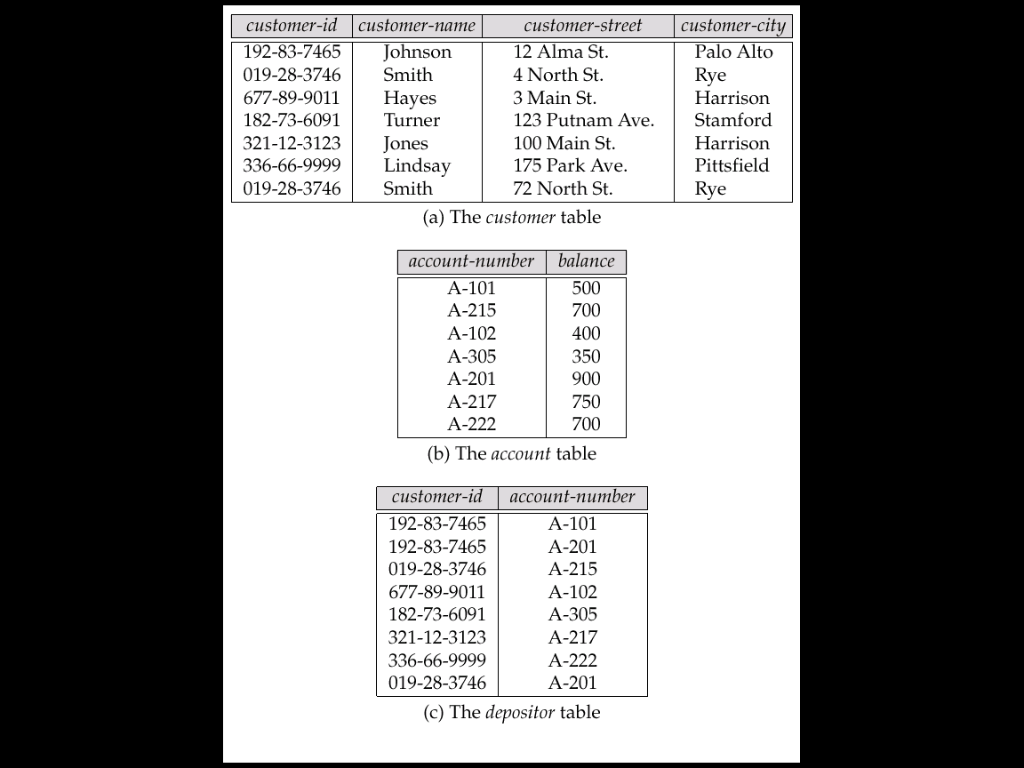
A Sample Relational Database

Slide 40
Data Manipulation Language
select instructor.name
from instructor
where instructor.dept_name=“History”;
select instructor.ID, department.dept_name
from instructor, department
where instructor.dept_name=department.dept_name and
department.budget > 95000;

Slide 41
Outline
Database system
Data view
DB languages
DB design
☞ DB engine
Database architecture
DB user and administrator
History of DB
Future directions

Slide 42
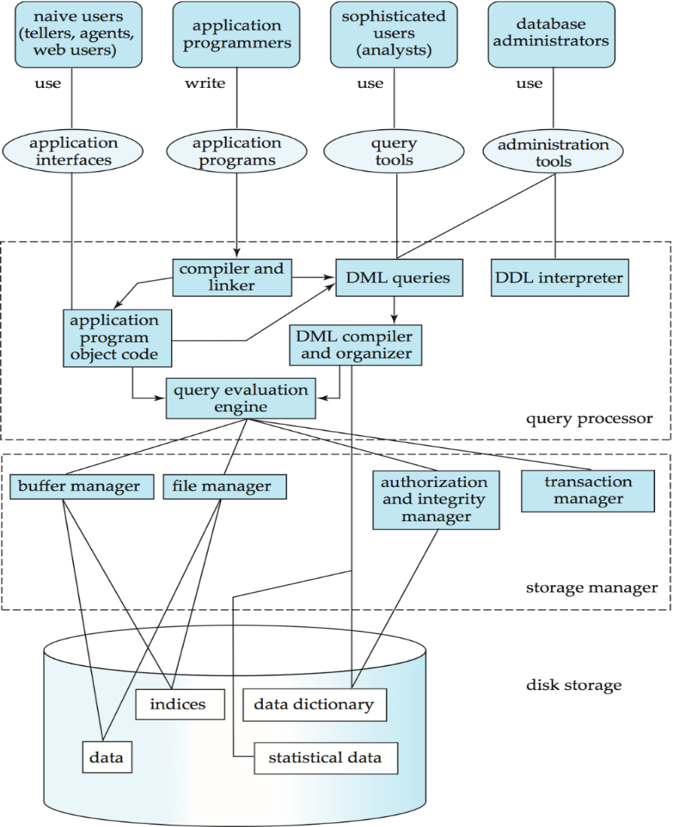
Users
Applications/tools
Database
System
Structure
DBMS
Database

Slide 43
Database engine
Storage manager
minimize the need to move data between disk and main memory
Query processor
translate updates and queries written in a nonprocedural language, at the logical level, into an efficient sequence of operations at the physical level such that helps the database system to simplify and facilitate access to data
Transaction manager
ensures that the database remains in a consistent (correct) state despite system failures, and that concurrent transaction executions proceed without conflicting

Slide 44
Storage Management
Storage manager is a program module that provides the interface between the low-level data stored in the database and the application programs and queries submitted to the system.
The storage manager is responsible for the following tasks:
Interaction with the file manager
The raw data are stored on the disk using the file system provided by the operating system. The storage manager translates the various DML statements into low-level file-system commands.
Efficient storing, retrieving and updating of data
Issues:
Storage access
File organization
Indexing and hashing

Slide 45
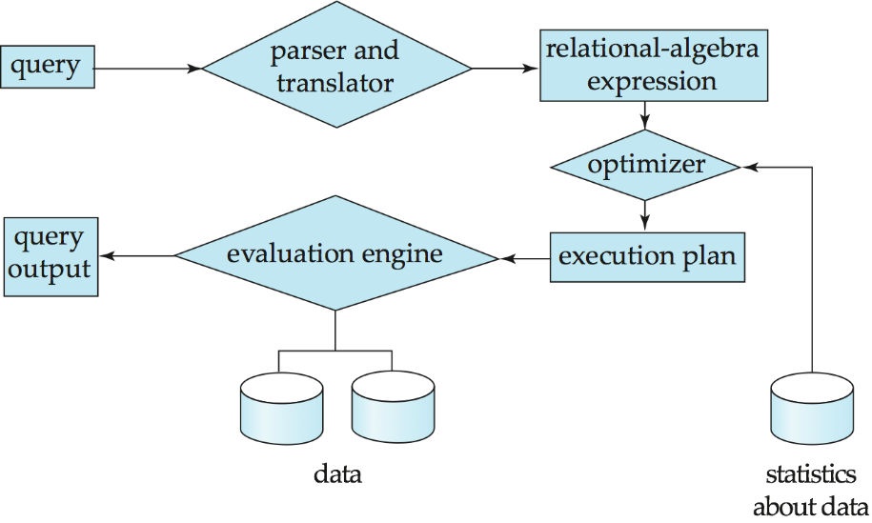
Query Processor Component
DDL interpreter
Parsing and translation: interprets DDL statements and records the definitions in the data dictionary.
DML compiler
Translates DML statements in a query language into an evaluation plan consisting of low-level instructions that the query evaluation engine understands.
Query optimization
Query evaluation engine
Executes low-level instructions generated by the DML compiler
Notes:
数据字典可能包含的信息，例如：
数据库设计资料
数据内部储存的SQL程序
用户权限
用户统计
数据库的过程中的信息
数据库增长统计
数据库性能统计

Slide 46
Transaction Management
Transaction
a collection of operations that perform a single logical function in a database application
Atomicity/consistency/isolation/durability (ACID)
Transaction manager
Ensure that the database remains in a consistent (correct) state despite system failures (e.g., power failures and operating system crashes) and transaction failures.
Concurrency control manager
Control the interaction among the concurrent transactions to ensure the consistency of the database.
Recovery manager
Failure recovery

Slide 47
Exercise
The transaction to transfer funds from the account of department A to the account of department B could be defined to be composed of two separate programs:
debits (借记) account A,
credits account B.
Will the execution of these two programs one after the other indeed preserve consistency?
Are programs A and B transactions?
Notes:
Y
N: each program by itself does not transform the database from a consistent state to a new consistent state. Thus, those programs are not transactions.

Slide 48
Outline
Database system
Data view
DB languages
DB design
DB engine
☞ Database architecture
DB user and administrator
History of DB
Future directions

Slide 49
Users
Applications/tools
Database
System
Structure
DBMS
Database

Slide 50
Database Architecture
The architecture of a database systems is greatly influenced by the underlying computer system on which the database is running:
Centralized
Client-server / Browser-server
Parallel (multi-processor)
Distributed

Slide 51
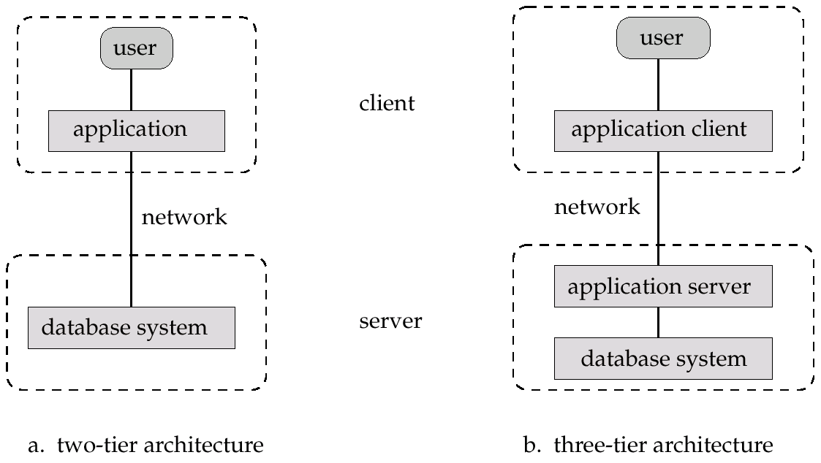
Application Architectures
Two-tier architecture: e.g., client programs using ODBC/JDBC to communicate with a database
Three-tier architecture: e.g., web-based applications, and applications built using “middleware”
Notes:
The application resides at the client machine, where it invokes database system functionality at the server machine through query language statements.
The client end communicates with an application server, usually through a forms interface. The application server in turn communicates with a database system to access data. The business logic of the application, which says what actions to carry out under what conditions, is embedded in the application server, instead of being distributed across multiple clients.
ODBC：开放式数据库连接
JDBC：Java Data Base Connectivity

Slide 52
Outline
Database system
Data view
DB languages
DB design
DB engine
Database architecture
☞ DB user and administrator
History of DB
Future directions

Slide 53
Database Users
Users are differentiated by the way they interact with the system
Naive users（无经验用户)
Use application programs that have been developed previously
E.g., people accessing database over the web, bank tellers, various apps
Application programmers (应用程序员)
Interact with system through DML calls
Sophisticated users（熟练的用户）
Form requests in a database query language
Specialized users （专门的用户）
Write specialized database applications that do not fit into the traditional data processing framework
computer-aided design systems, knowledge base and expert systems, systems that store data with complex data types (e.g., graphics data and audio data), and environment-modeling systems

Slide 54
People Working with DBMS
End users
Query/update databases through application user interfaces (e.g., Amazon.com, 同心云, 本研一体化系统, etc.)
Database designers
Design database “schema” to model the real world
Database application developers
Build applications that interact with databases
Database administrators (a.k.a. DBA)
Load, back up, and restore data
Fine-tune databases for better performance
DBMS implementors
Develop the DBMS or specialized data management software
Implement new techniques for query processing and optimization inside DBMS

Slide 55
Database Administrator (DBA)
Coordinate all the activities of the database system, and have a good understanding of the enterprise’s information resources and needs, as well as DBMS
DBA's duties
Schema definition
Storage structure and access method definition
Schema and physical organization modification
Granting of authorization for data access
Routine maintenance
Specify integrity constraints
Act as liaison with users
Monitor performance, and respond to changes in requirements
Notes:
Liaison：联络员

Slide 56
Outline
Database system
Data view
DB languages
DB design
DB engine
Database architecture
DB user and administrator
☞ History of DB
Future directions

Slide 57
History of Database Systems
1950s and early 1960s:
Data processing using magnetic tapes for storage
Tapes provide only sequential access
Punched cards for input
Late 1960s and 1970s:
Hard disks allow direct access to data
Network and hierarchical data models in widespread use
Edgar F Codd defines the relational data model
Won the ACM Turing Award for this work
IBM Research begins System R prototype
UC Berkeley begins Ingres prototype
High-performance (for the era) transaction processing
1980s:
Relational prototypes evolve into commercial systems
SQL becomes industrial standard
Parallel and distributed database systems
Object-oriented database systems
1990s:
Large decision support and data-mining applications
Large multi-terabyte data warehouses
Emergence of Web commerce
2000s
Big data storage systems
Google BigTable, Yahoo PNuts, Amazon
“NoSQL” systems.
Big data analysis: beyond SQL
Mapreduce
2010s
Massive distributed database systems
Multi-core main-memory databases
Automated database administration
Streaming, mobile data management
Trusted data management (data privacy)
Uncertain data management

Slide 58
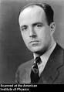
Milestones in DBMS History (1)
Factor out data management functionalities from applications and standardize these functionalities
CODASYL (Conference on Data Systems Language) standard (circa 1960’s)
Developed the first database management system IDS (Integrated Data Store)
Charles Bachman got a Turing award in 1973
Charles Bachman
(Dec. 11, 1924 – July 13, 2017)
Master of Upen
He received the ACM Turing Award in 1973 for "his outstanding contributions to database technology"
Notes:
Charles Bachman was born in Manhattan, Kansas, in 1924, where his father, Charles Bachman Jr., was the head football coach at Kansas State College. He attended high school in East Lansing, Michigan.
In World War II he joined the United States Army and spent March 1944 through February 1946 in the South West Pacific Theater serving in the Anti-Aircraft Artillery Corps in New Guinea, Australia, and the Philippine Islands. There he was first exposed to and used fire control computers for aiming 90 mm guns.
After his discharge in 1946 he attended Michigan State College and graduated in 1948 with a bachelor's degree in Mechanical Engineering where he was a member of Tau Beta Pi. In mid-1949 he married Connie Hadley. He then attended the University of Pennsylvania. In 1950, he graduated with a master's degree in Mechanical Engineering, and had also completed three-quarters of the requirements for an MBA from the university's Wharton School of Business.
Bachman died on July 13, 2017, at his home in Lexington, Massachusetts, of Parkinson's disease at the age of 92.

Slide 59

Milestones in DBMS History (2)
The relational revolution (1970’s)
A simple data model: data is stored in relations (tables)
A declarative query language: SQL
Provided physical data independence
The single most important reason behind the success of DBMS today
A Turing Award for E. F. Codd in 1981
E. F. Codd
(August 23rd, 1923 - April 18th, 2003)
Bachelor of Oxford, PhD of Michigan
E. F. Codd, A Relational Model of Data for Large Shared Data Banks, Communications of ACM 13, No. 6, June 1970.

Slide 60

Milestones in DBMS History (3)
Transaction processing in 1980s
Jim Gray got a Turing Award for this work in 1998
Jim Gray was lost at sea on 28 Jan, 2007
In 2008, Microsoft announced the opening of Microsoft Jim Gray Systems Lab in Madison, Wisconsin
Jim Gray (1944-2007)
the first CS PhD of Berkeley
He received the Turing Award in 1998 "for seminal contributions to database and transaction processing research and technical leadership in system implementation."

Slide 61

Milestones in DBMS History (4)
Michael Stonebraker (1943-)
His career covers, and helped create, the majority of the existing relational database market today. He is also the founder of Ingres (PostgreSQL的前身), Illustra, StreamBase Systems, Vertica, VoltDB, SciDB and was previously the CTO of Informix
He has received several awards, including the IEEE John von Neumann Medal and the first SIGMOD Edgar F. Codd Innovations Award. He was inducted as a Fellow of ACM in 1994
2014 ACM Turing Award Winner for fundamental contributions to the concepts and practices underlying modern database systems
Michael Stonebraker (1943-)
Bachelor (Princeton);
Master/PhD (U. of Michigan)
Prof. (Berkeley);
Adjunct Prof. (MIT)
Graduate from famous universities
All worked for IT industries for a long time
Active in academy and contributed a lot to DB development

Slide 62
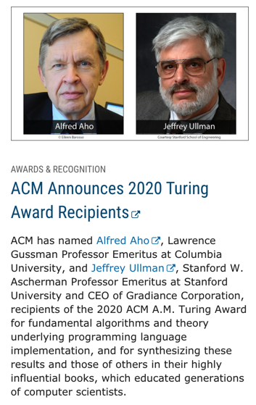
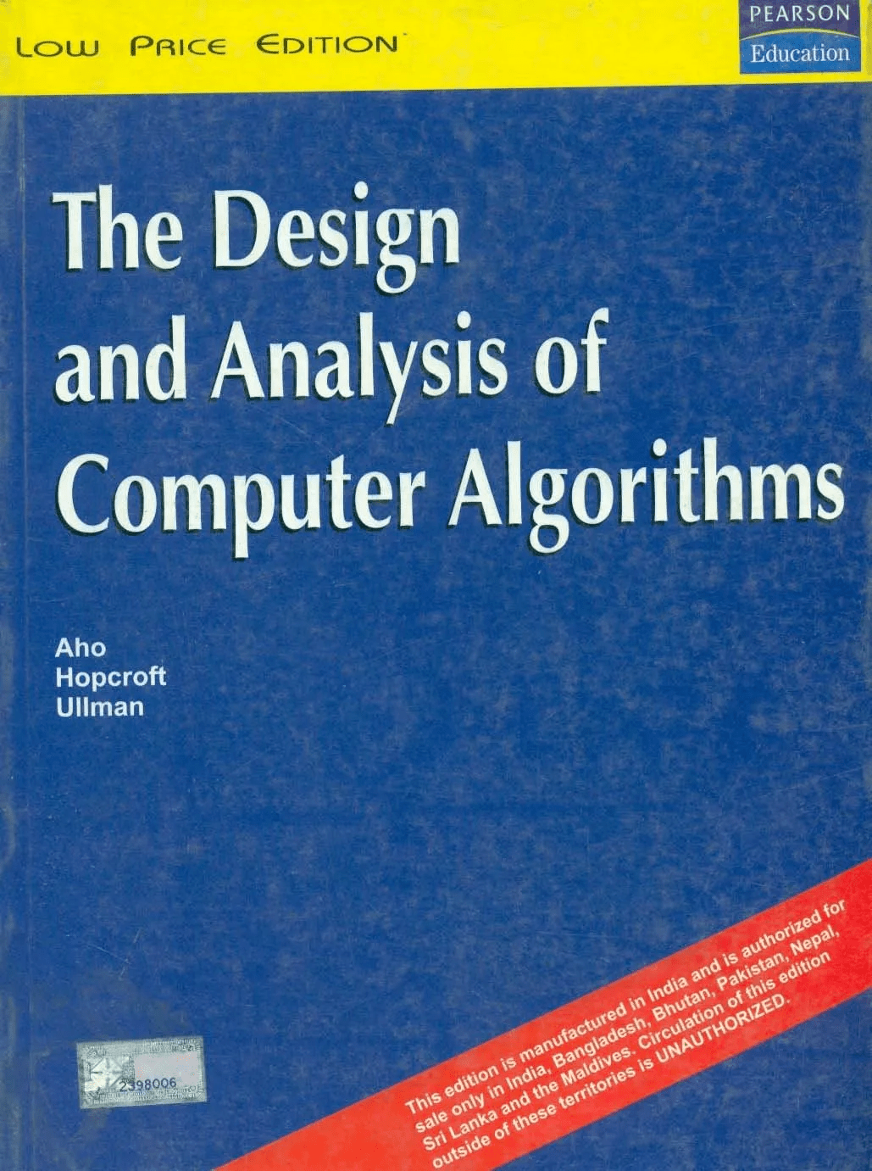
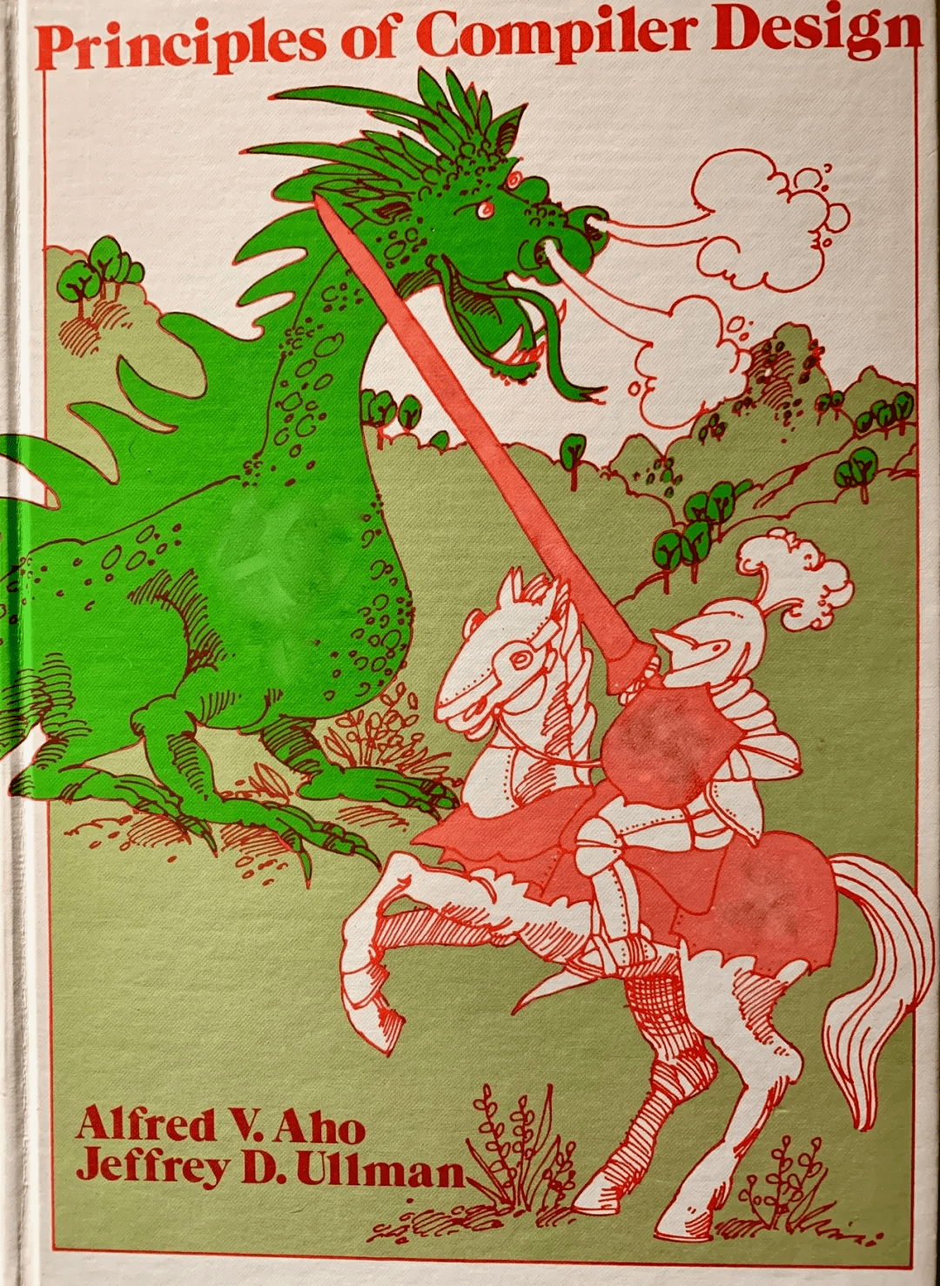
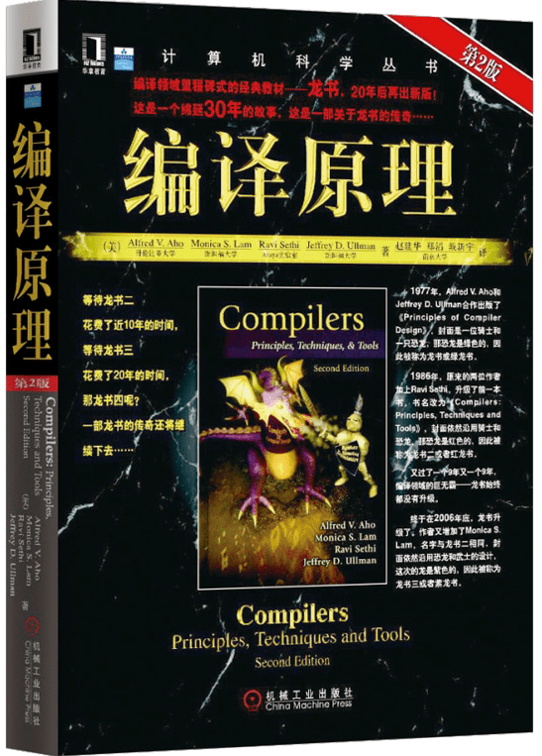
Jeffrey Ullman
《计算机算法设计与分析》(1974)
《 The Design and Analysis of Computer Algorithms》
《编译程序设计原理》(1977)
《Principles of Compiler Design 》(1977)
这本书的最新版本《编译原理》（与Ravi Sethi和Monica Lam合著）于2007年出版，至今仍是有关编译器设计的标准教科书

Slide 63
Major DBMS Today
Major commercial DBMS products
Oracle
IBM DB2 (from System R, System R*, Starburst)
Microsoft SQL Server
Sybase
Informix (acquired by IBM), …
Open source DBMS
PostgreSQL (from UC Berkeley’s Ingres, Postgres)
MySQL
Others
NoSQL (Not only SQL, for big data): HBase, MongoDB, Neo4J, Redis, Cassandra
NewSQL: OceanBase, openGauss, etc.

Slide 64
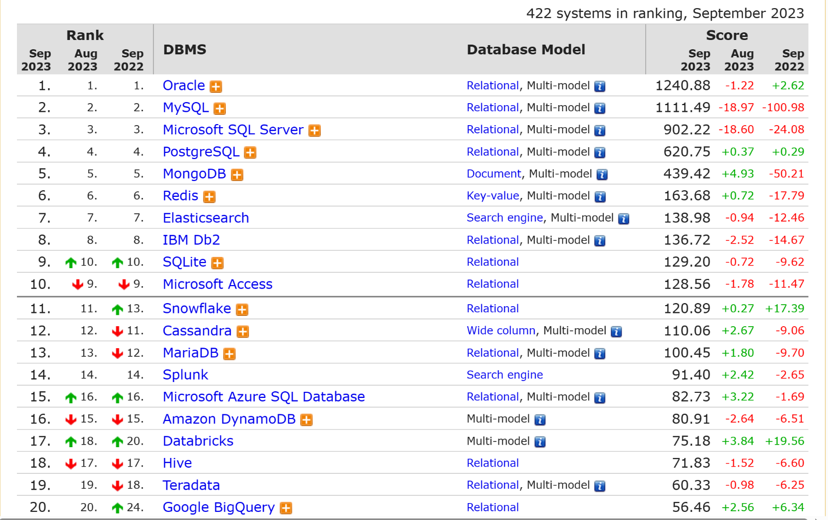
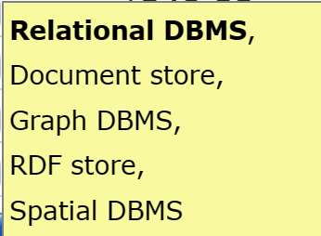
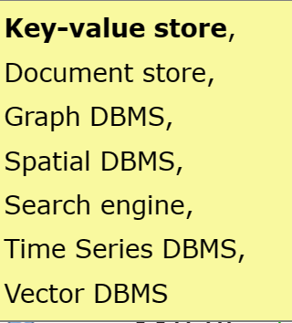
DB-Engines Ranking
Oracle：Multi-model
Redis：Multi-model
https://db-engines.com/en/ranking

Slide 65
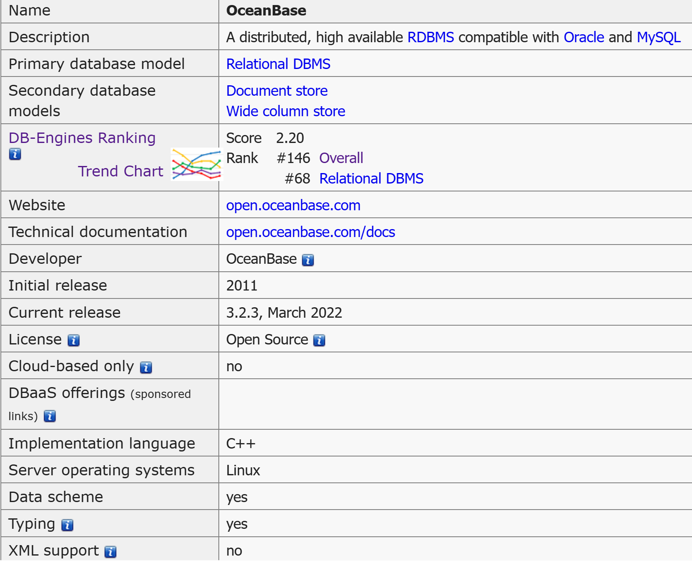
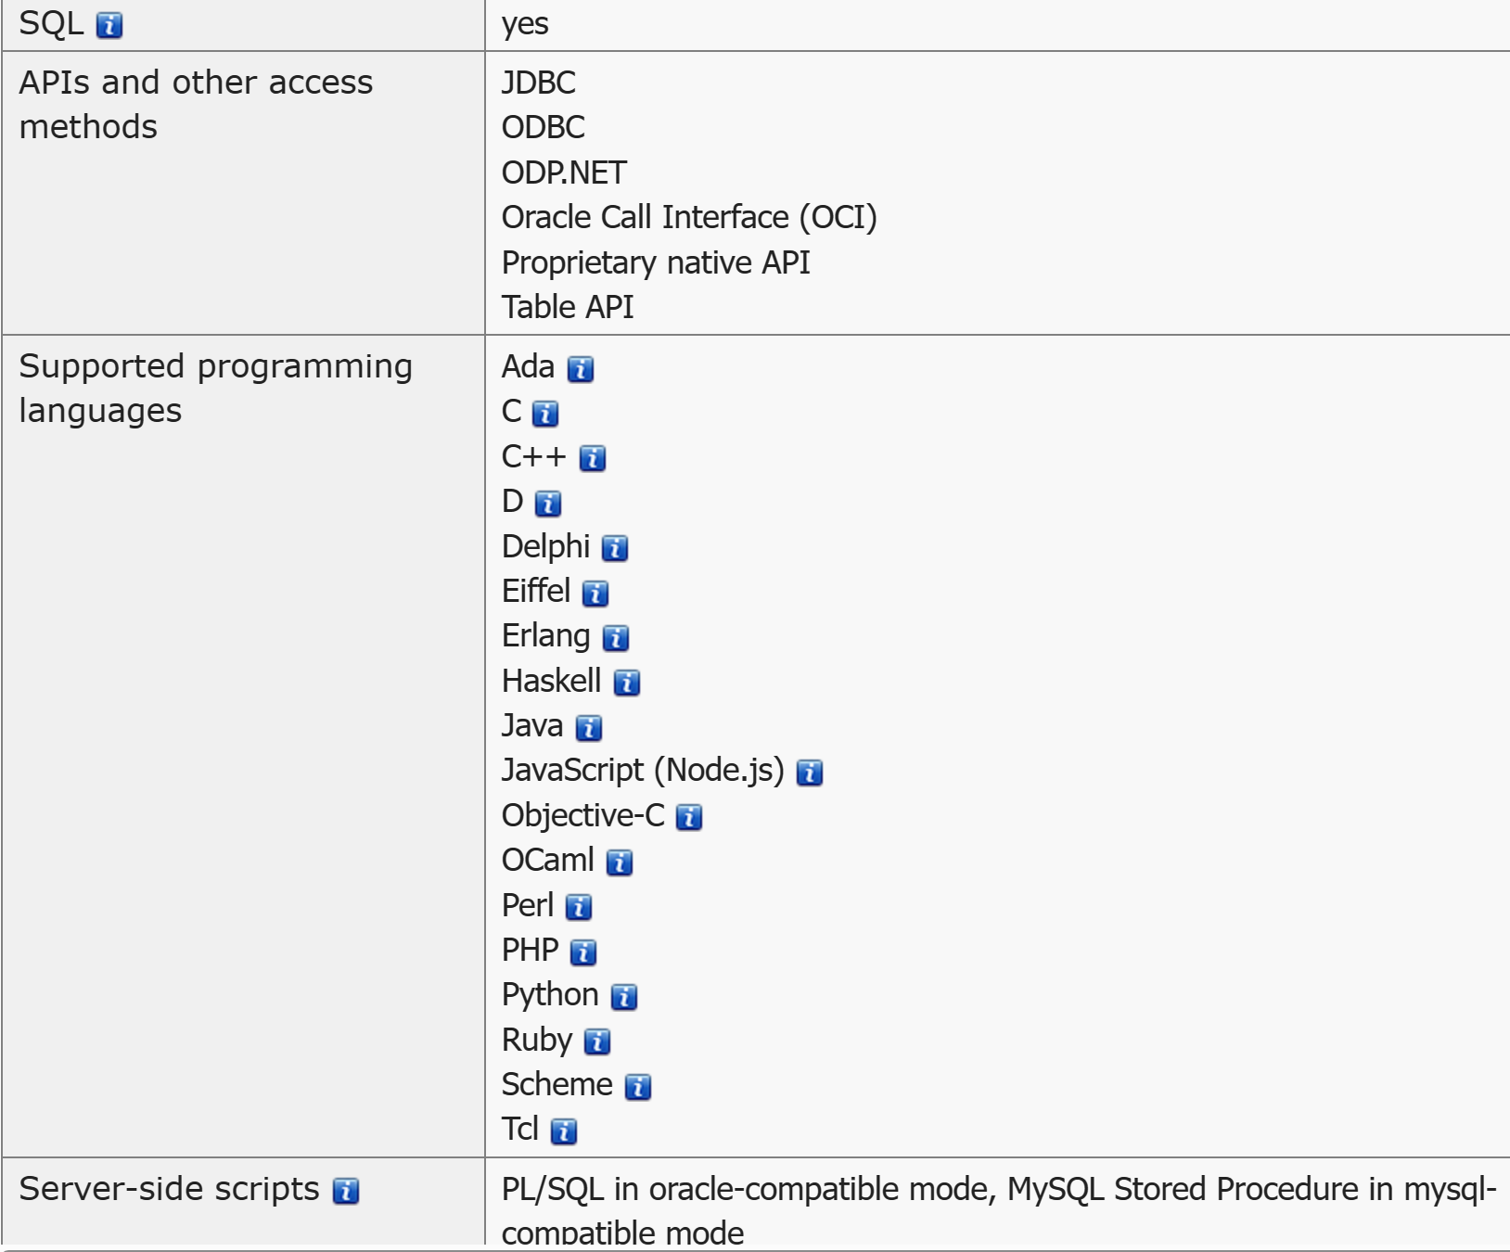
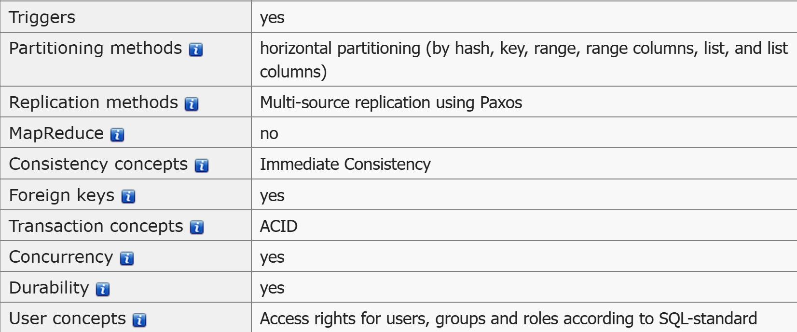
DB-Engines - OceanBase System
OceanBase System Properties (db-engines.com)

Slide 66
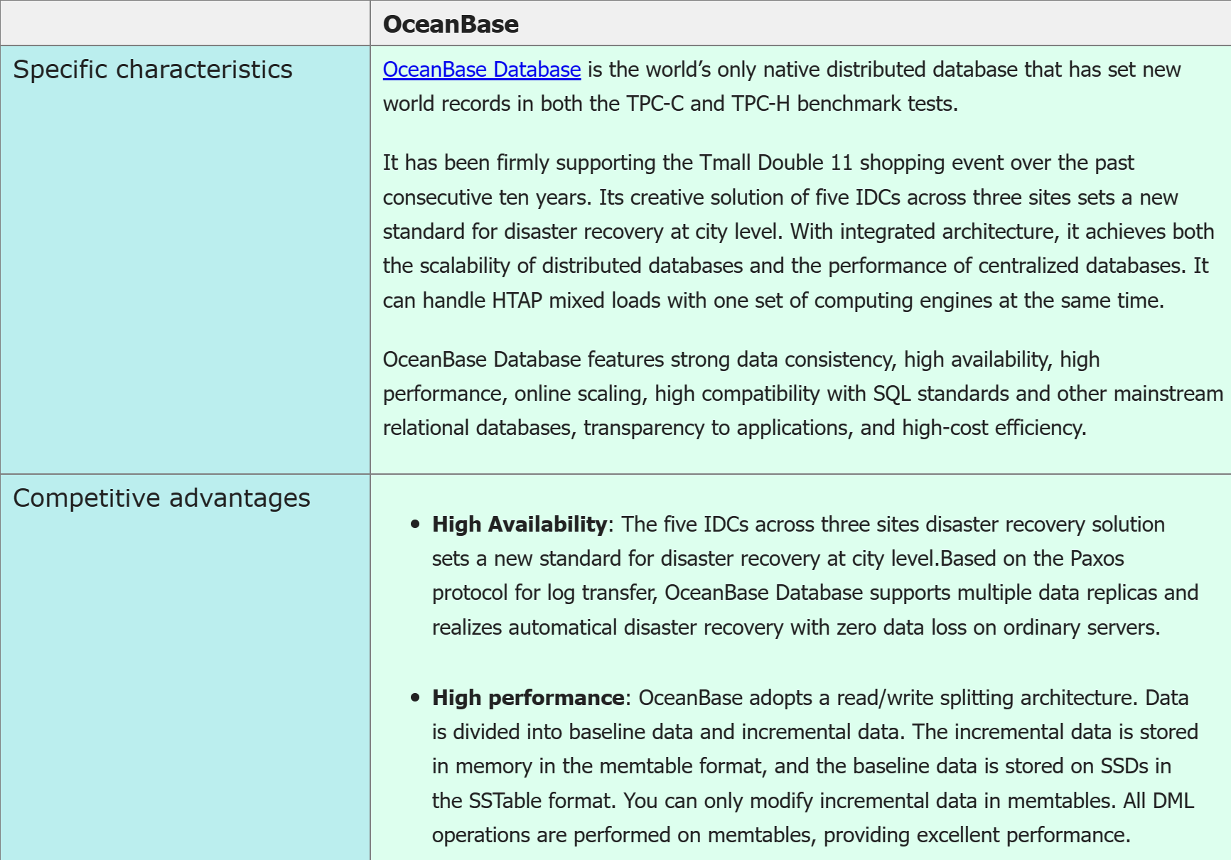
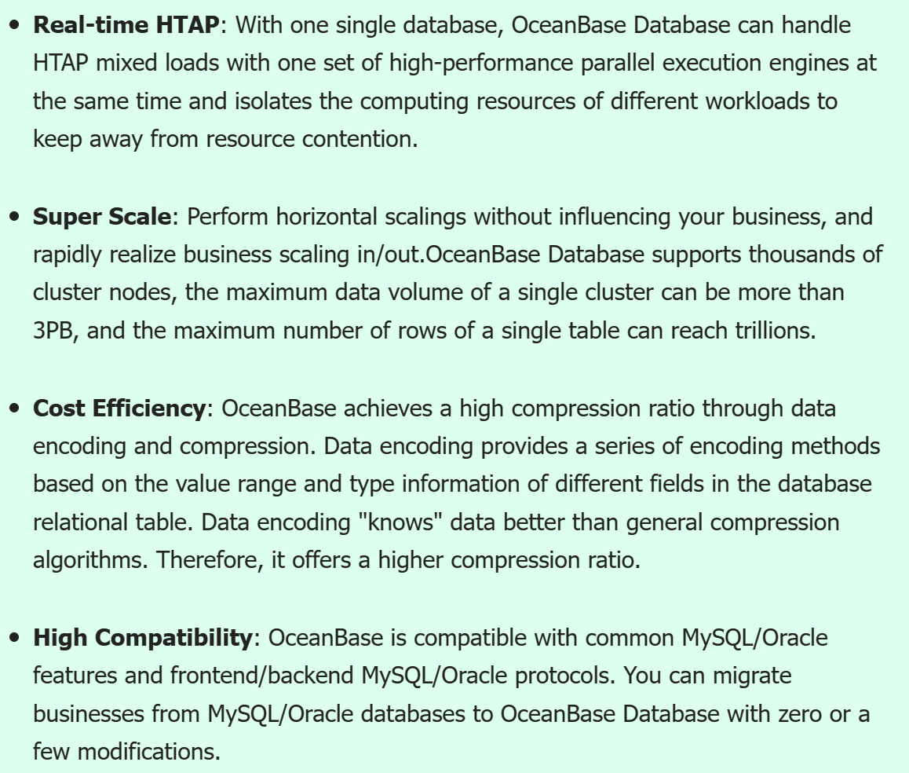

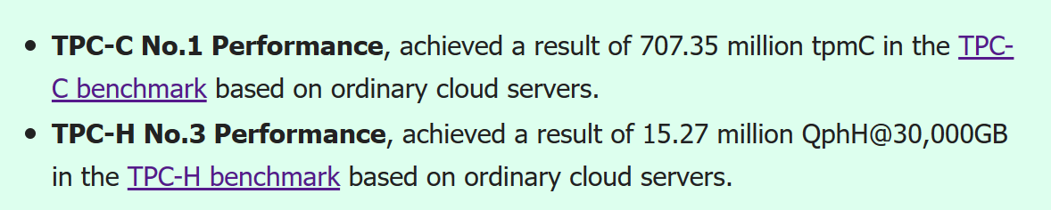
DB-Engines - OceanBase System
OceanBase System Properties (db-engines.com)
Notes:
HTAP：Hybrid Transaction / Analytical Processing, 混合事务分析处理，即同时支持 OLTP 和 OLAP 场景

Slide 67
Outline
Database system
Data view
DB languages
DB design
DB engine
Database architecture
DB user and administrator
History of DB
☞ Future directions

Slide 68
数据库的3次主要变革
在过去的50年里, 数据库主要经历了3次变革:
第1代是单机数据库, 解决了数据存储、数据管理和查询处理等问题, 代表系统包括Oracle, PostgreSQL和MySQL等
第2代是集群数据库, 旨在为企业关键业务提供高可用性和可靠性保障, 代表系统包括Oracle RAC, IBM DB2和Microsoft SQL Server
第3代是分布式数据库和云原生数据库, 旨在解决大数据时代的弹性计算和动态数据迁移问题, 代表系统包括亚马逊Aurora、华为openGauss和蚂蚁科技的OceanBase
Notes:
RAC: real application clusters

Slide 69
大数据时代，数据库系统主要面临的挑战
基于专家经验的传统优化技术(如代价估计、连接顺序选择、参数调优)已经不能满足异构数据、海量应用和大规模用户对性能的需求，可以设计基于学习的数据库优化技术，使数据库更智能
AI时代，很多数据库应用需使用人工智能算法，如数据库中的图像搜索，可以将人工智能算法嵌入到数据库，利用数据库技术加速人工智能算法，并在数据库中提供基于人工智能的服务
传统数据库侧重使用通用硬件(如CPU)，不能充分发挥新硬件(如ARM、AI芯片)的优势

Slide 70
AI4DB (CCF数据库战略会议-2020年5月30日)
人工智能技术可以在多个维度为数据库赋能:
1) 人工智能模型可以作为外挂工具为数据库提供优化服务, 比如外挂的SQL重写工具, 先给出SQL语句的优化建议, 再传递给数据库内核执行;
2) 人工智能模型可以融合到数据库内部, 提供运行时优化, 比如我们可以把配置优化模块植入查询优化器, 提供查询级别的参数调优;
3) 用人工智能算法代替数据库传统组件, 比如提供学习型优化器、学习型索引、学习型视图构建等等, 甚至可以利用人工智能算法对数据库重组织, 根据负载特性自动生成合适的执行路径;
4) 把人工智能技术融入到数据库的整个生命周期, 在数据库部署的各个阶段提供智能优化;
5) 用人工智能技术改造查询优化模块, 由于合理的执行计划对于查询处理非常重要, 可以通过在查询解析、处理、优化的各个层次结合合适的人工智能技术, 提高执行计划的生成效率和表现;
6) 用人工智能技术优化数据库运维, 数据库运维对于保证数据库可用性、可靠性等诸多方面有着重要意义, 包括状态监控、问题诊断、性能评估、意外处理等多个方面, 通过结合人工智能技术, 数据库可以实现自诊断、自愈、自监控, 进而解放人力实现自动运维;
7) 用人工智能技术保证数据库安全, 数据库安全对于确保用户隐私信任非常重要, 传统的数据隐藏、加密技术多有被破解的隐患, 通过结合深度学习, 利用复杂的神经元连接方式进行数据隐藏、加密和访问控制, 可以极大提升数据库的安全性.

Slide 71
DB4AI (CCF数据库战略会议-2020年5月30日)
人工智能技术严重依赖于数据，通过有效结合数据库在存储、管理和操作数据上的优势，人工智能的训练和学习过程可以更加高效。此外, 数据库不仅能为人工智能提供数据，而且能更好地支持人工智能服务。从建模、训练、重用的角度来看：
1) 利用统一的SQL接口，用户可以使用用户定义的函数或存储过程轻松构建人工智能模型；
2) 训练人工智能模型需要进行大量的张量计算，通过扩展关系代数，数据库可以更好地支持张量计算，并统一在执行器中执行，有助于模型训练；
3) 收敛的人工智能模型可以以物化视图、查询表等方式持久化，方便用户重用，但要在数据库上支持人工智能技术，还有一些亟待解决的问题；
首先，人工智能和数据库有不同的使用方式。通常，用python或R语言编写人工智能模型，但使用SQL语句访问关系数据库中的数据。因此调用人工智能相关的服务有两个问题：
1) 在编写人工智能的应用程序时，人们需要经常在不同的系统之间切换；
2) 传统的数据分析师只知道一些SQL知识，编写人工智能代码并不轻松。因此，如果我们能够扩展解析规则，使SQL同时支持DB和AI，那么提供与AI相关的服务将更加方便；
其次，人工智能技术多基于张量数据模型，现有数据库还不能很好支持这类数据模型。因此，我们需要扩展的关系代数和统一的数据模型来在数据库上支持人工智能服务。

Slide 72
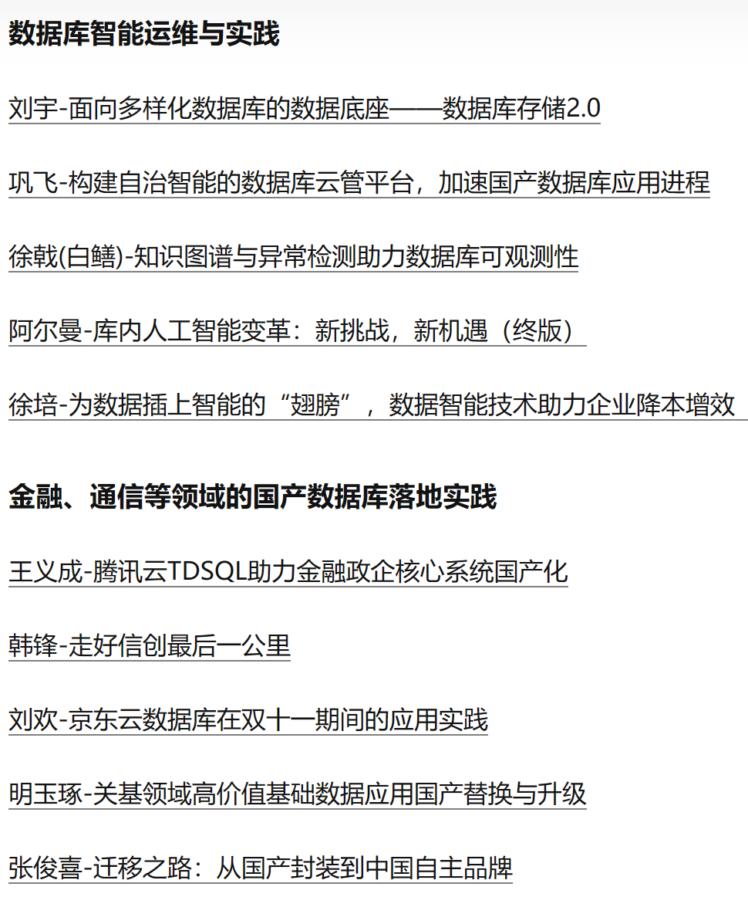
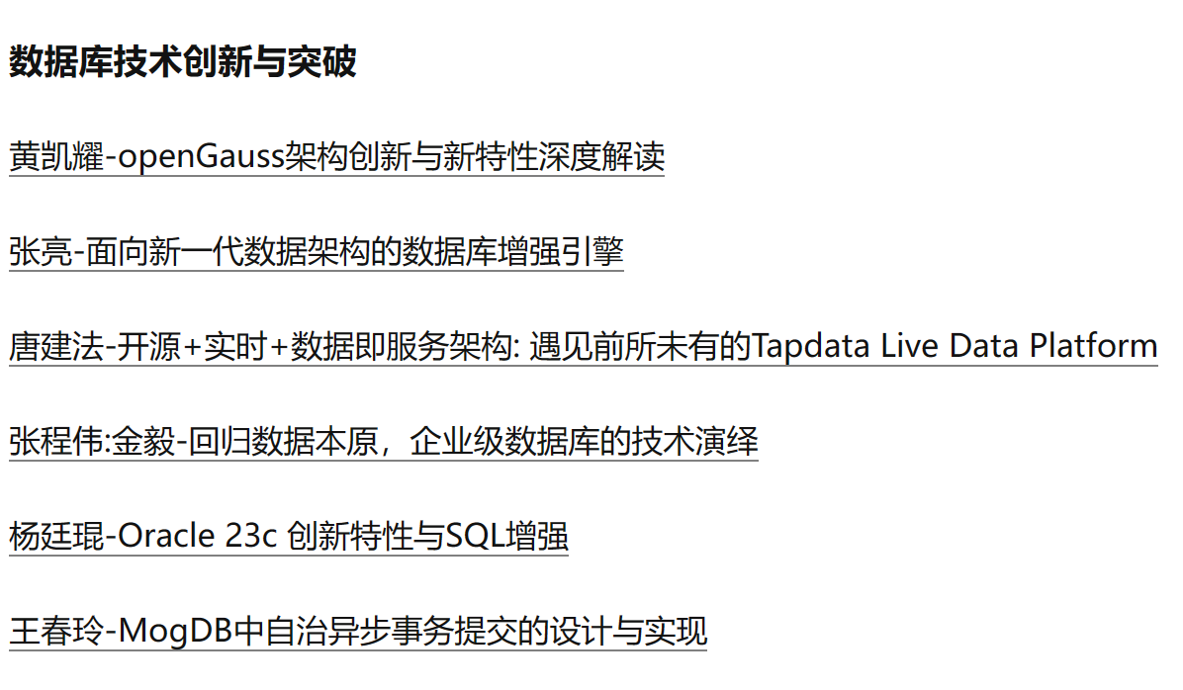
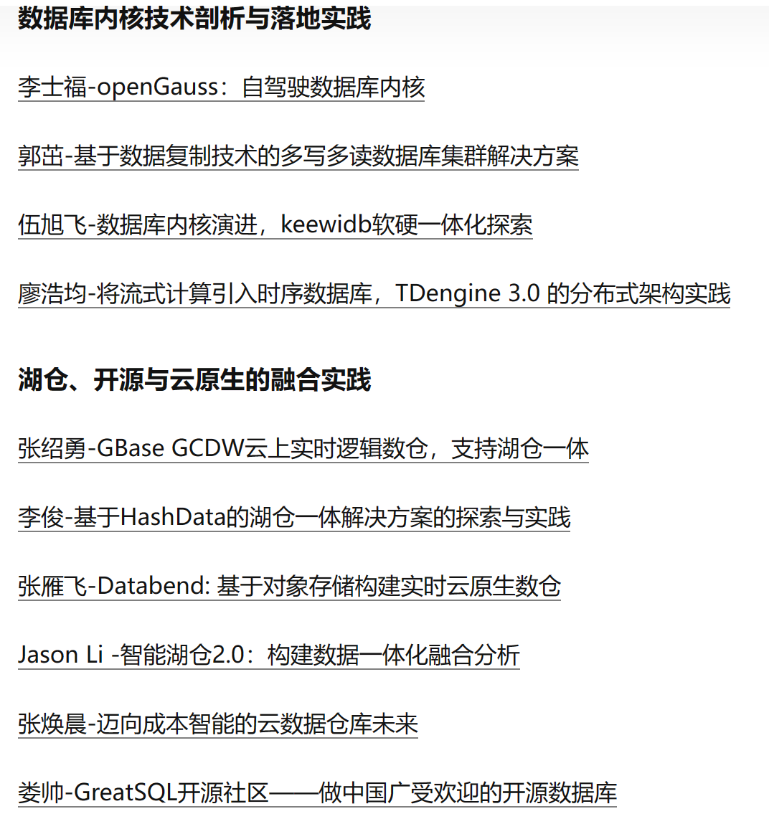
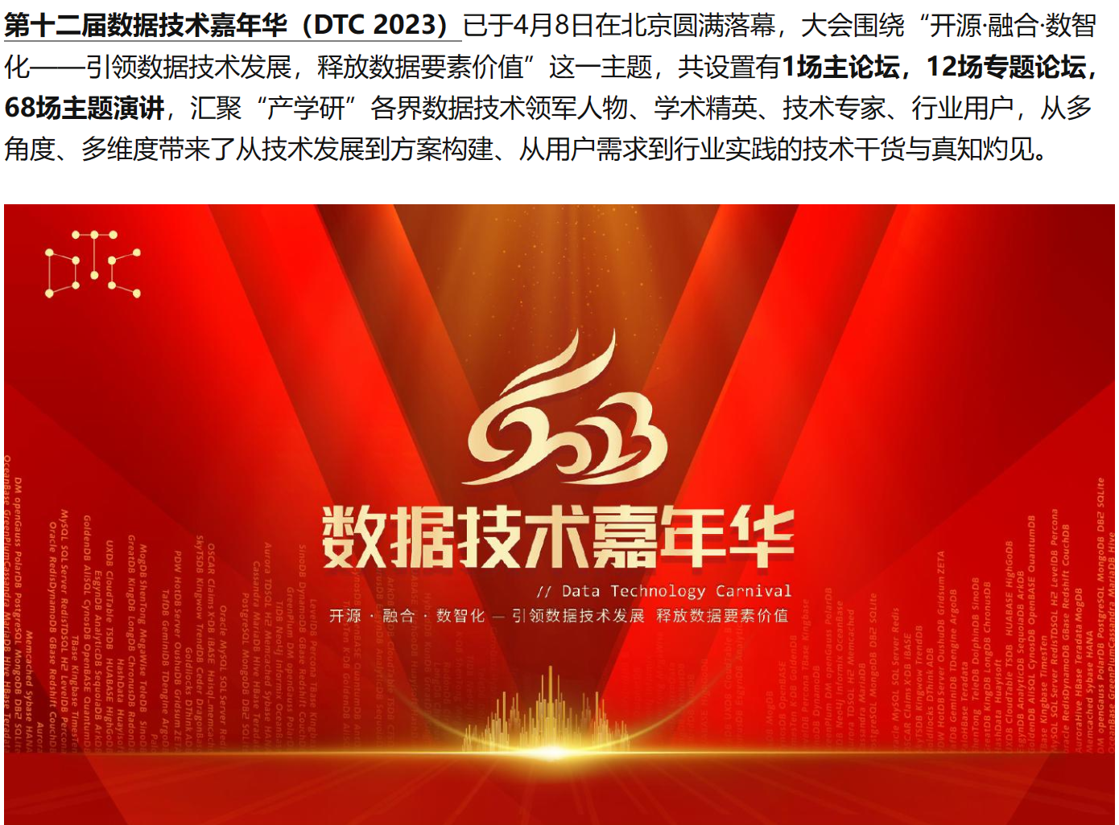
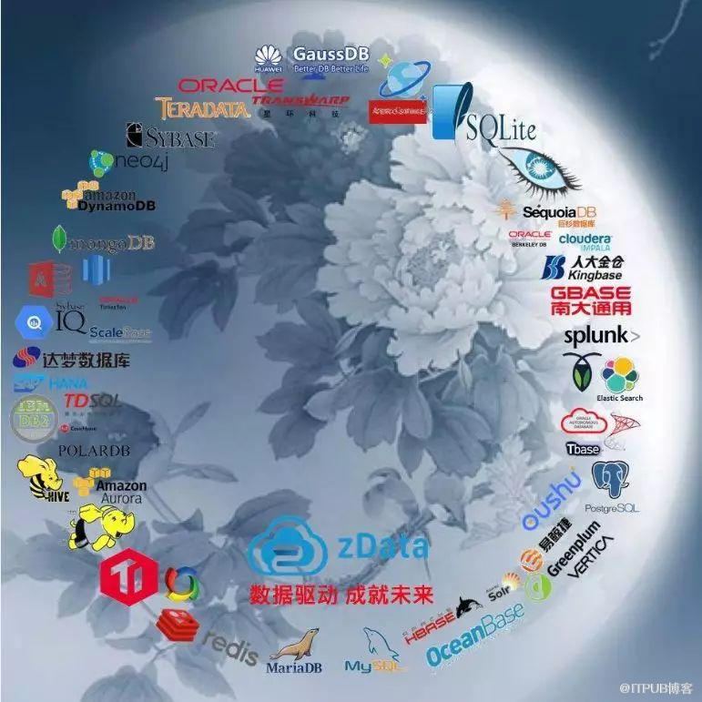
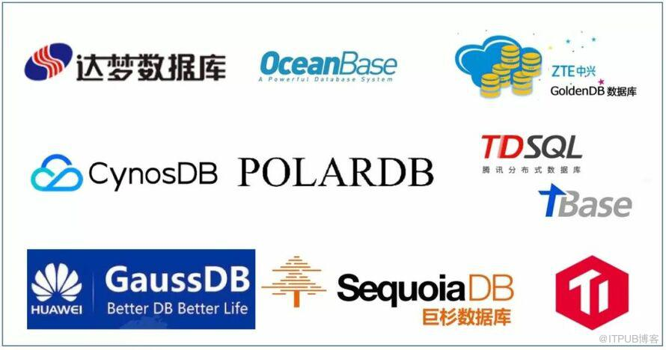
2019年数据技术嘉年华(2019.11.15-16)
2019年，大会以 “ 开源 • 智能 • 云数据 － 自主驱动发展 创新引领未来” 为主题，打造 “ 开源自研，云和数据，智能运维，智能业务，数据前沿，用户实践” 六大模块。2019年数据库行业，在墨天轮数据库流行度排行榜上， Oracle 依旧保持龙头位置，MySQL扛起开源大旗，两度荣膺“年度数据库”的PostgreSQL 持续崛起，越来越多的数据库产品在实践中找到最佳场景。大量国产数据库在国际市场大舞台上更加瞩目，赢得很强的国际竞争力：OceanBase 在 TPC-C 测试中，登顶夺冠；华为 GaussDB 声名鹊起；阿里云POLARDB高歌猛进, 最终推动了客户业务的发展、助力了客户案例的成功，数据技术真正成为了驱动企业进步的核心动力。
参加 2019 数据技术嘉年华大会的国产数据库包括：
华为GaussDB 、阿里巴巴 PolarDB、蚂蚁金服OceanBase、巨杉数据库、PingCap TiDB、腾讯TDSQL、腾讯TBase、达梦数据库等

Slide 73
蚂蚁金服OceanBase简介
OceanBase由蚂蚁金服完全自主研发的金融级分布式关系数据库，创于2010年，具有数据强一致、高可用、高性能、在线扩展、高度兼容SQL标准和主流关系数据库、低成本特点。
OceanBase已经在建设银行、南京银行、西安银行、人保健康险、常熟农商行、苏州银行、广东农信、网商银行等多家商业银行和保险机构上线。
2020年5月，OceanBase以7.07亿（707,351,007）tpmC（即每分钟内系统处理的新订单个数，transactions per minute, TPC-C）的在线事务处理性能，打破了OceanBase自己在2019年10月创造的6088万（60,880,800）tpmC的TPC-C世界纪录(Oracle 为30,249,688)。
2020年6月8日，蚂蚁集团宣布，将自研数据库产品OceanBase独立进行公司化运作，成立由蚂蚁100%控股的数据库公司北京奥星贝斯科技，并由蚂蚁集团CEO胡晓明亲自担任董事长。
OceanBase是一个支持海量数据的高性能分布式数据库系统，实现了数千亿条记录、数百TB数据上跨行跨表事务，由淘宝核心系统研发、运维、DBA、广告、应用研发等部门共同完成。在设计和实现OceanBase的时候暂时摒弃不紧急的DBMS的功能，例如临时表、视图view等，研发团队把有限的资源集中到关键点上，当前 OceanBase主要解决数据更新一致性、高性能的跨表读事务、范围查询、join、数据全量及增量dump、批量数据导入等

Slide 74
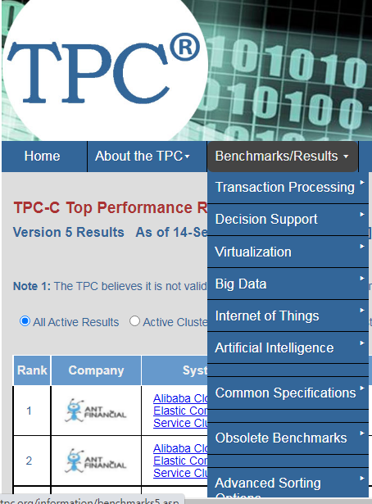
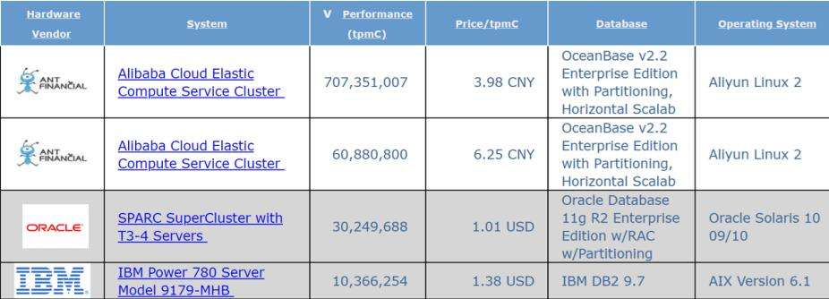

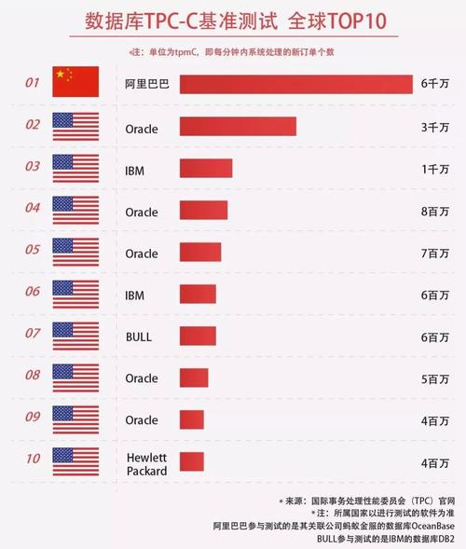
数据库TPC-C基准测试排名(2020.05/2019.10)
http://www.tpc.org/tpcc/

Slide 75
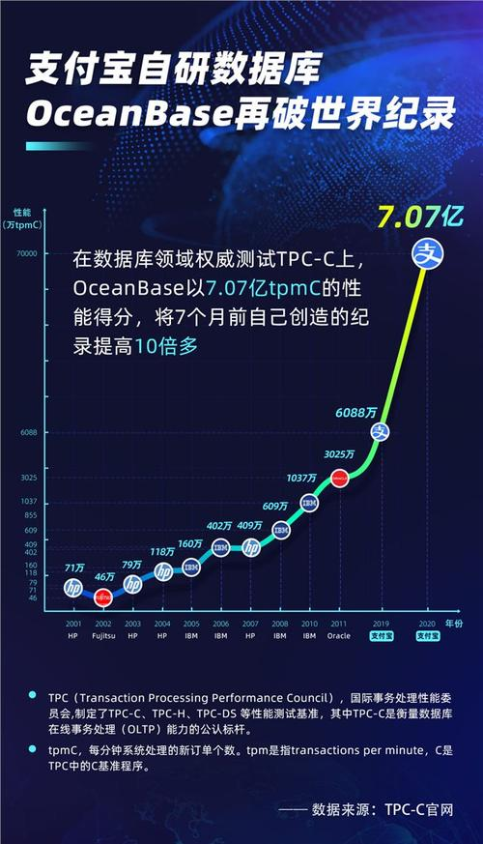
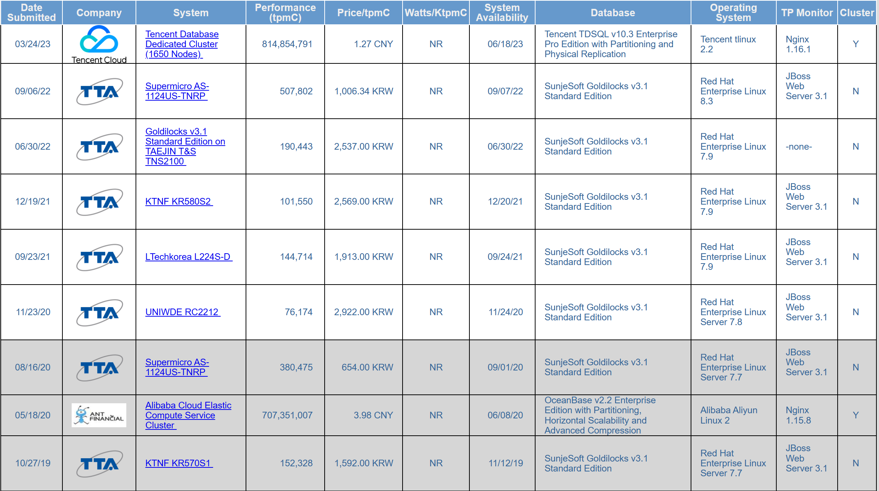
数据库TPC-C基准测试排名(2020.05/2019.10)

Slide 76
华为openGauss简介
GaussDB 数据库是2019年 5 月 15 日华为在北京面向全球发布的，被称为全球首个人工智能原生（AI-Native）数据库。
根据华为的介绍，GaussDB 具有两大革命性突破：
首次将 AI 技术融入分布式数据库的全生命周期，实现自运维、自管理、自调优、故障自诊断和自愈。在交易、分析和混合负载场景下，基于最优化理论，首创基于深度强化学习的自调优算法，调优性能比业界提升 85%
通过异构计算创新框架充分发挥多种算力优势，在权威标准测试集 TPC-DS 上，性能比业界提升 48%
2019年9月19日在华为全联接大会上，华为宣布将开源其数据库产品，开源后命名为openGauss, 2020 年 6 月30日openGauss数据库源代码正式开放。
openGauss是一款开源关系型数据库管理系统，采用木兰宽松许可证v2发行。openGauss内核源自PostgreSQL，深度融合华为在数据库领域多年的经验，结合企业级场景需求，持续构建竞争力特性。同时openGauss也是一个开源、免费的数据库平台，鼓励社区贡献、合作。

Slide 77
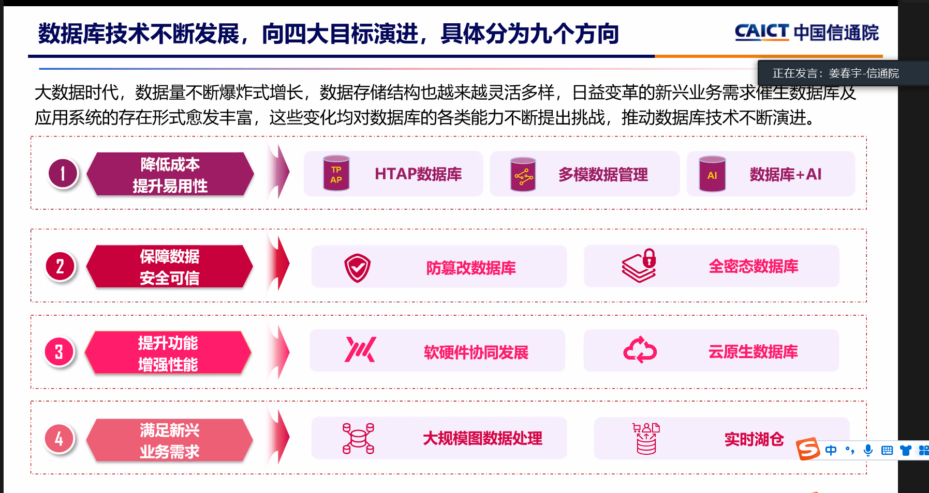
内容来自NDBC2022

Slide 78
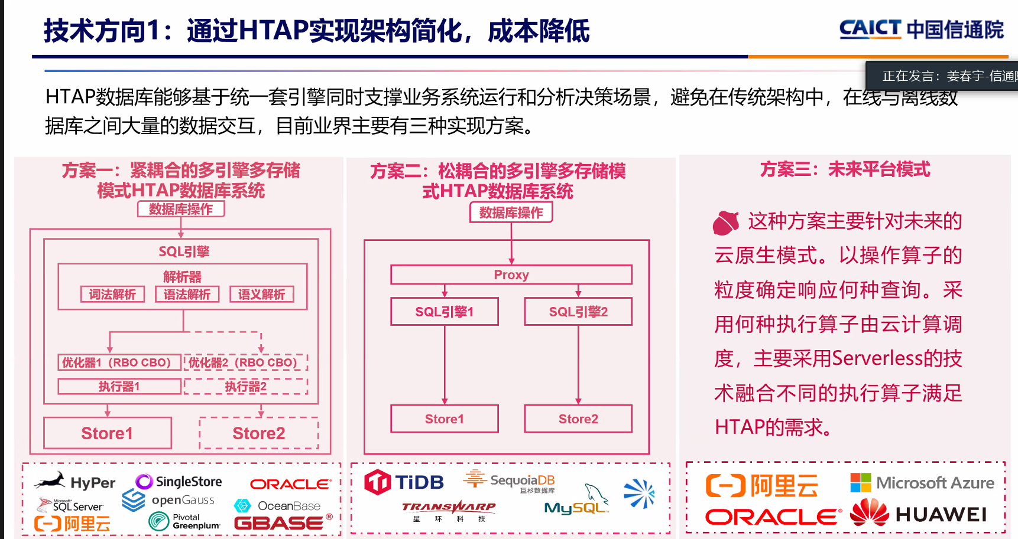
Notes:
HTAP(Hybrid transaction and analysis processing)数据库，也称混合型关系数据库，是能同时提供OLTP和OLAP的混合关系型数据库。

Slide 79
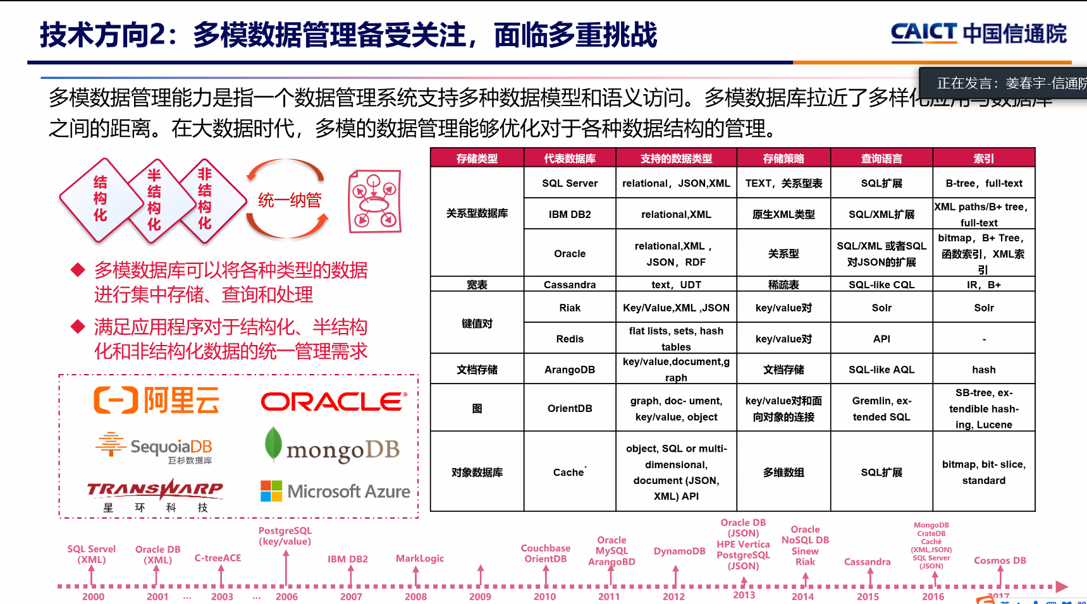

Slide 80
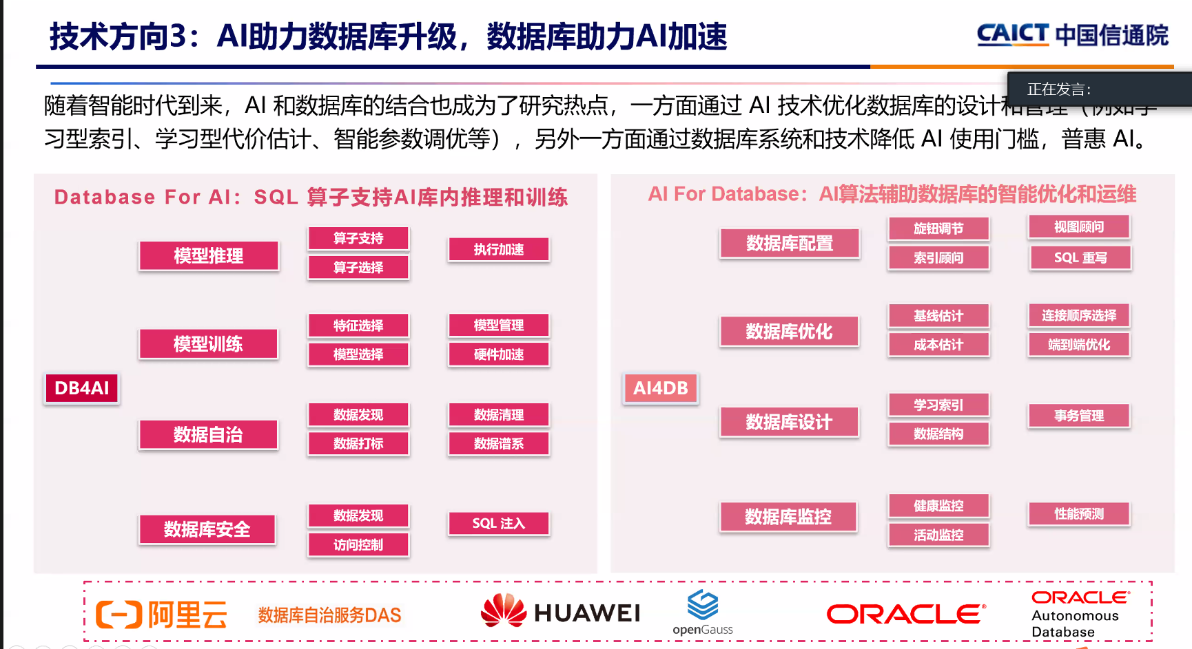

Slide 81
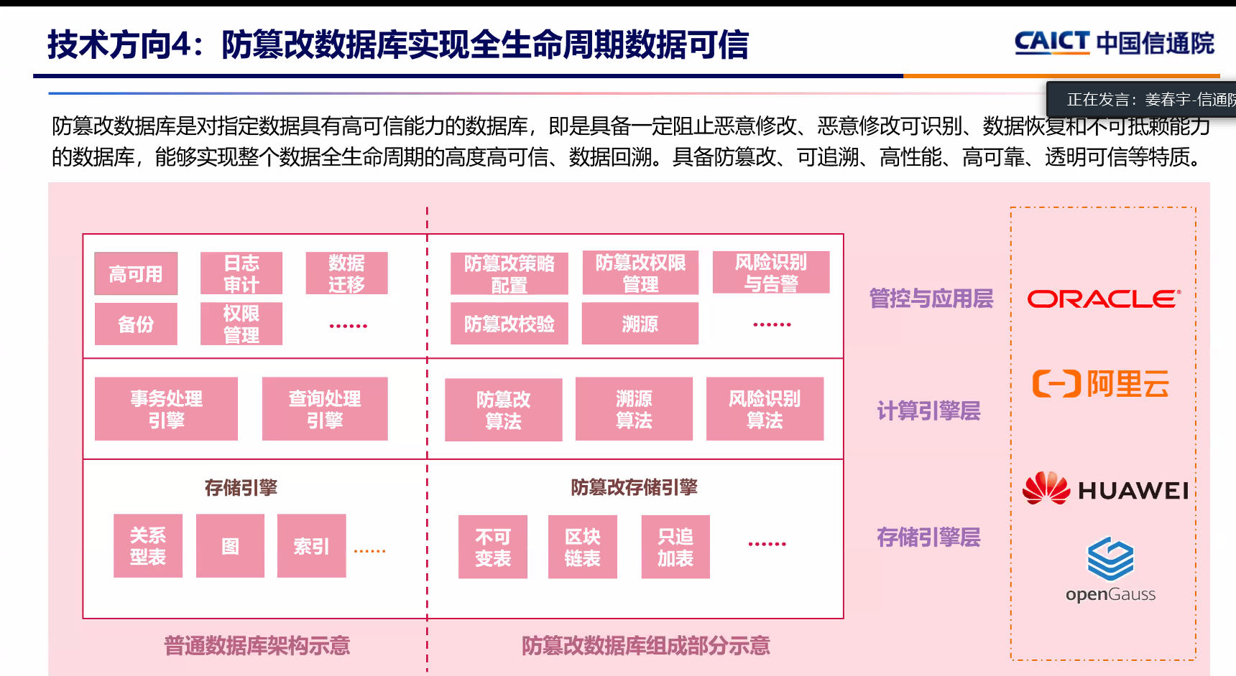

Slide 82
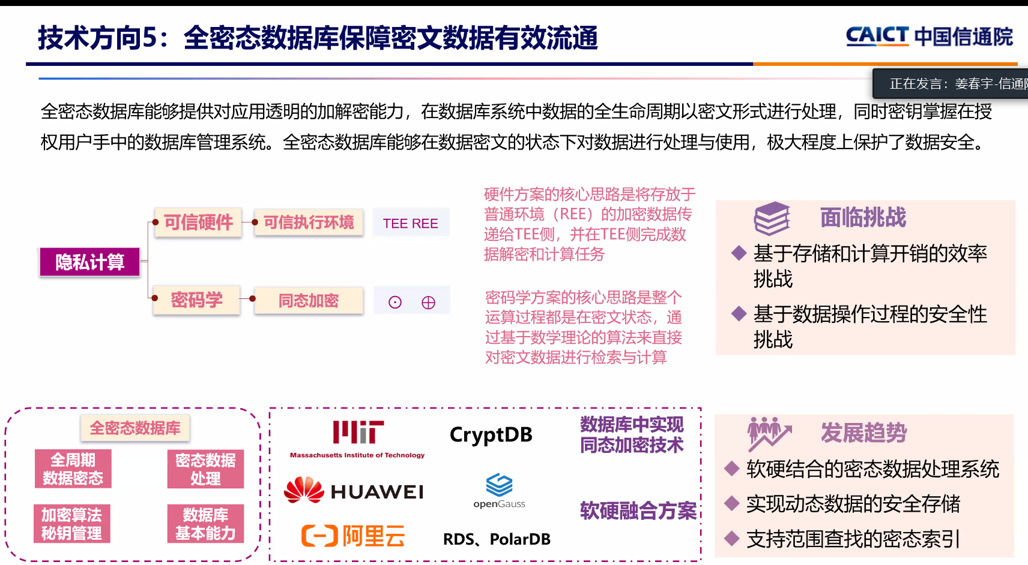

Slide 83
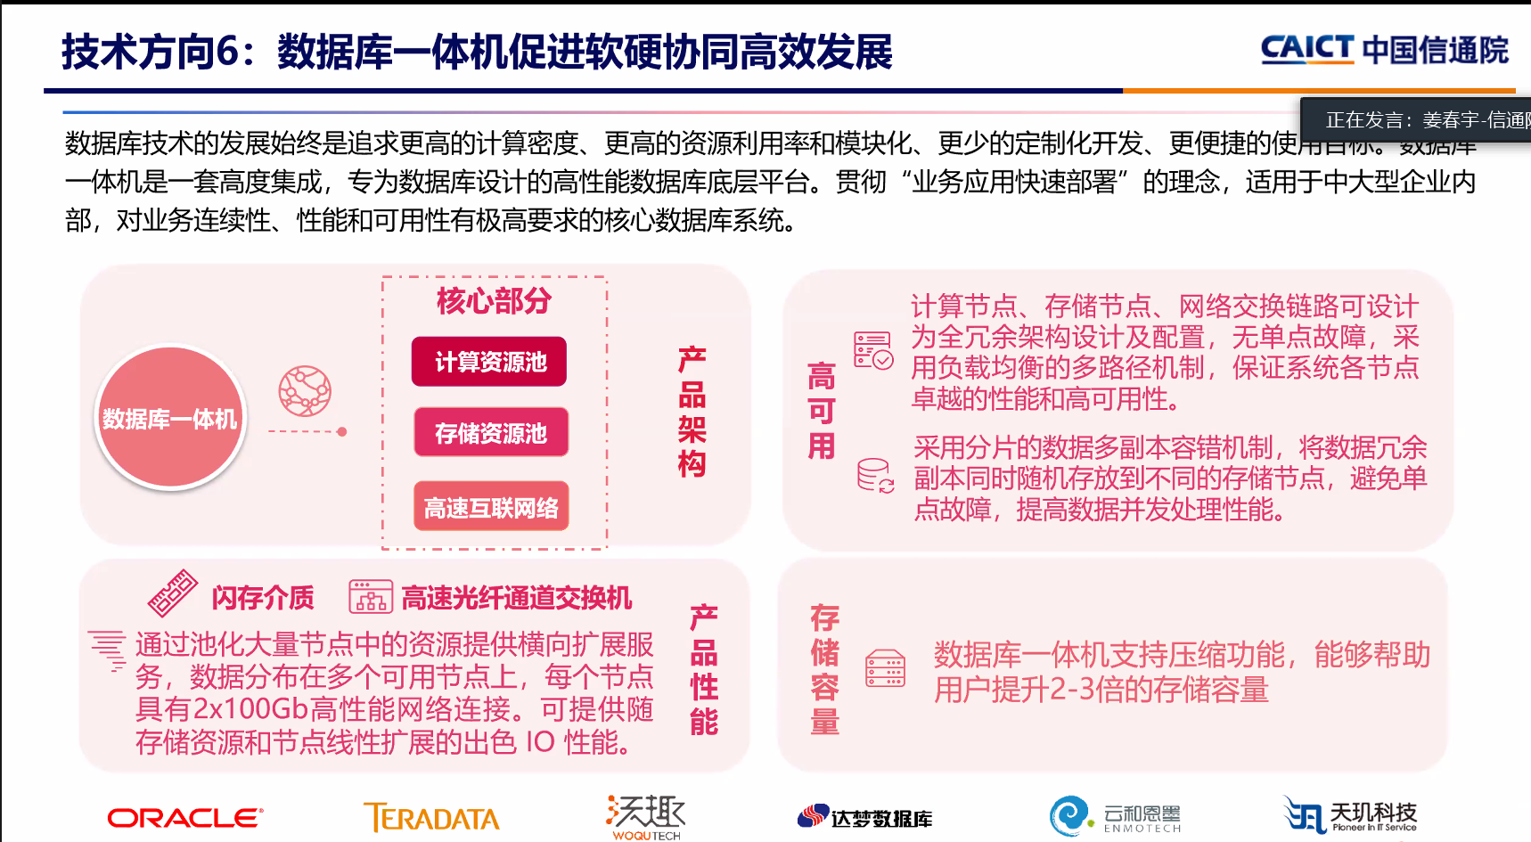

Slide 84
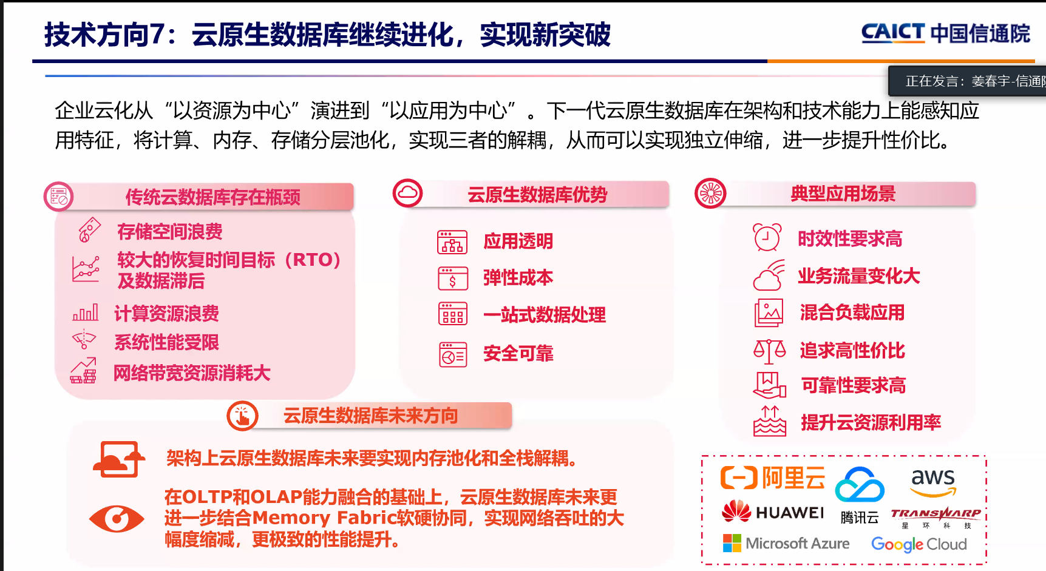

Slide 85
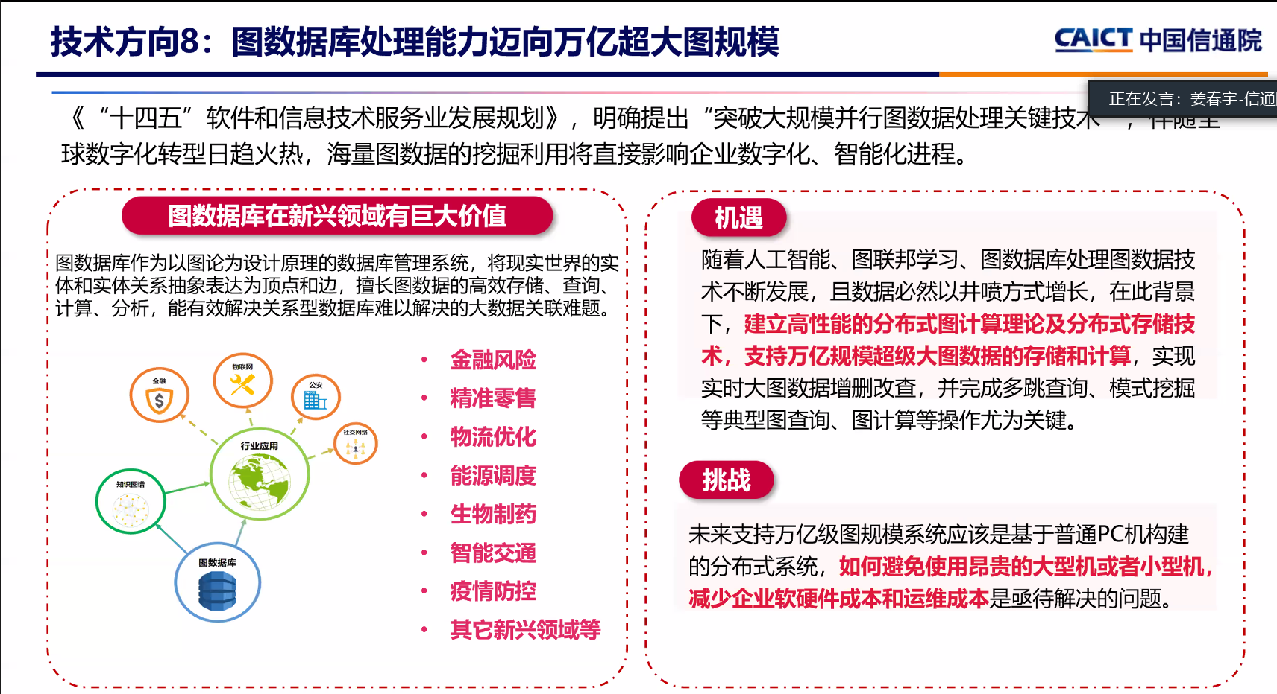

Slide 86
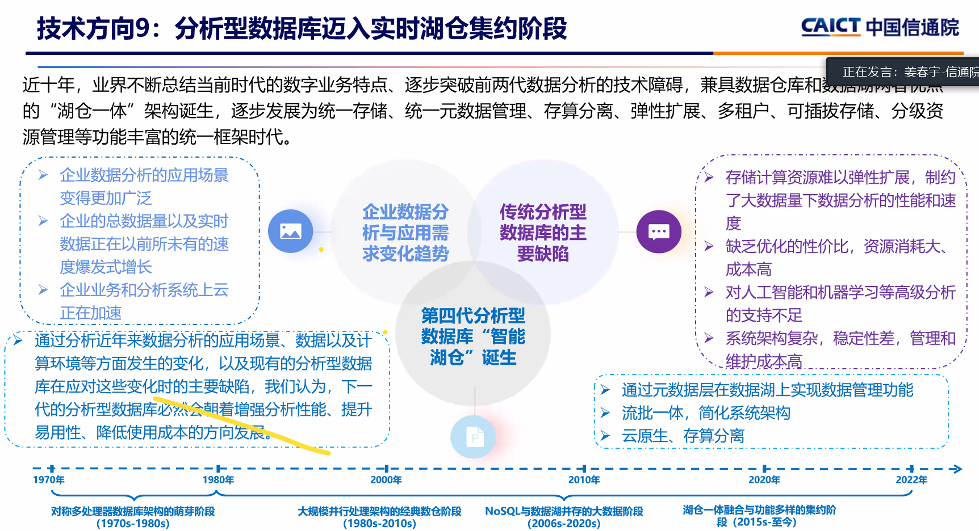

Slide 87
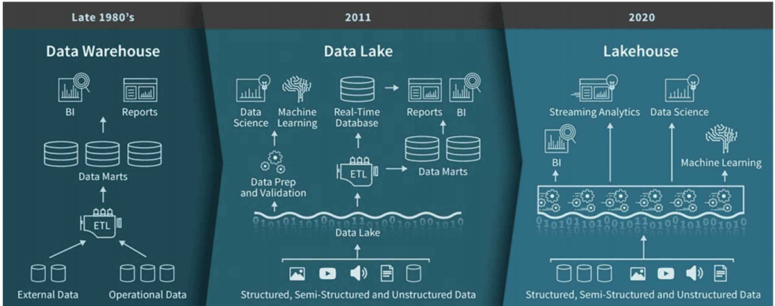
Data Warehouse, Data Lake & Lakehouse

Slide 88
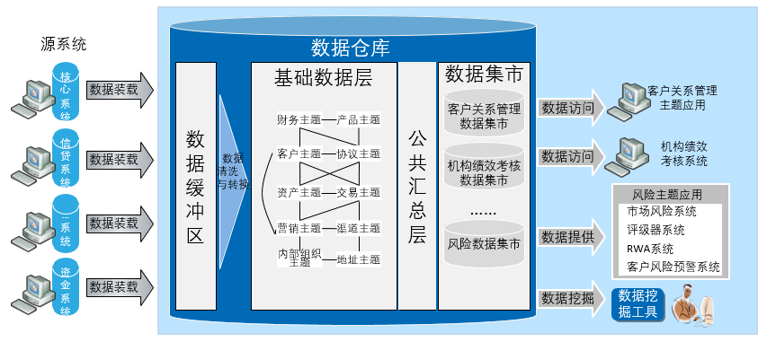
数据仓库（Data Warehouse）
一个面向主题的、集成的、相对稳定的、反映历史变化的数据集合，用于支持管理决策和信息的全局共享

Slide 89
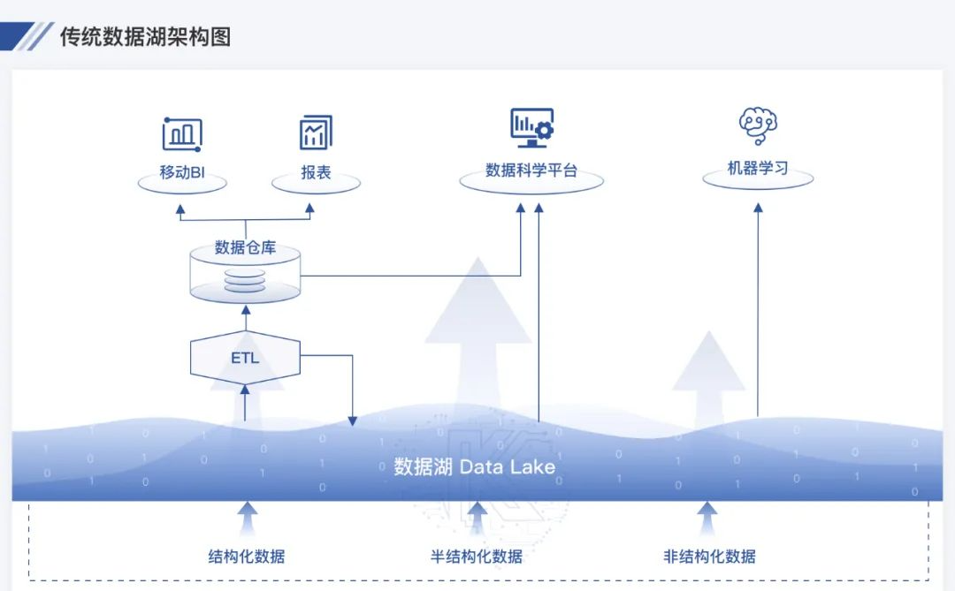
数据湖（Data Lake）
数据湖是一种不断演进中、可扩展的大数据存储、处理、分析的基础设施。它就像一个大型仓库，可以存储任何形式（包括结构化和非结构化）和任何格式（包括文本、音频、视频和图像）的原始数据

Slide 90

数据仓库 vs. 数据湖

Slide 91

湖仓一体（Lakehouse）
湖仓一体是一种新型开放式架构，将数据湖和数据仓库的优势充分结合，它构建在数据湖低成本的数据存储架构之上，又继承了数据仓库的数据处理和管理功能，打通数据湖和数据仓库两套体系，让数据和计算在湖和仓之间自由流动

Slide 92


Slide 93


Slide 94


Slide 95


https://www.modb.pro/dbRank

Slide 96


Slide 97




ML -强化学习
强化学习（Reinforcement Learning, RL）？
核心思想：智能体（Agent）在环境（Environment）中学习，根据环境的状态(State)，执行动作(Action)，并根据环境的反馈(Reward)来指导更好的动作。
Agent 智能体
两部分
Environment 环境
RL
Environment
State状态/Observation观测值
三要素
Action动作
Action:$↑$
Reward
Reward奖励
Agent
State: pixel

Slide 98







强化学习RL应用

Slide 99



强化学习RL应用
股票
交通治理
Agent: 控制器
Environment: 股票市场
State: 股票历史曲线
Action: 买入金额、卖出金额
Reward: 股票累积收益
Agent: 交通灯控制器
Environment: 路况信息
State: 各个路口摄像头输入的图像
Action: 红黄绿灯的亮灭
Reward: 0- 路口滞留车辆数（拥堵情况）
1997 年，IBM 的深蓝打败了国际象棋世界冠军卡斯帕罗夫.
2017 年，Google的 AlphaGo 打败了世界排名第一围棋手柯洁.

Slide 100






强化学习RL应用
2017年，OpenAI 在 Dota 2 的年度最大赛事 TI7 上，用英雄影魔 1 vs 1 模式打败了世界级中路 Solo 王 Dendi.
2019年，Google 旗下的 DeepMind开发的AlphaStar 在《星际争霸 2》中战胜职业玩家。
Dota 2 是一个每秒 30 帧的游戏，而 AI 每 4 帧会对游戏作出反应，选择什么都不做或是移动、普攻、放技能、传送、回城、治疗等等行为。在不断地训练中，技能的施放点，或是移动的方位， AI 最终都会找到最优解。
AI 在你躲进树林里，他没有视野的情况下。也会跟进树林，去搜索你.
AI还会猜测的你走的路线，并打出预判技能.
时不时的去 Gank 一下，以人数或是有预谋的偷袭行为去压制对方.

Slide 101
Database Research: Challenges and Opportunities
An overview on the Claremont 2008 / Beckman 2013 Report / other materials

Slide 102
Challenges
Architectural shifts in computing
At the macro scale, the rise of “cloud” computing services suggests fundamental changes in software architecture
At a micro scale, computer architectures have shifted the focus of Moore’s Law from increasing clock speed per chip to increasing the number of processor cores and threads per chip
In storage technologies, major changes are underway in the memory hierarchy, due to the availability of more and larger on-chip caches, large inexpensive RAM, and flash memory
Power consumption has become an increasingly important aspect of the price/performance metric of large systems

Slide 103
Opportunities (1)
Revisiting database engines: Traditional data engine NOT work well
OLTP System: data provenance, schema evolution and versioning
Text indexing
Media delivery
Revisiting Database Engines
designing systems for clusters of many-core processors
exploiting remote RAM and Flash as persistent media, rather than relying solely on magnetic disk
treating query optimization and physical data layout as a unified, adaptive, self-tuning task to be carried out continuously
compressing and encrypting data at the storage layer, integrated with data layout and query optimization;
designing systems that embrace non-relational data models, rather than “shoehorning” them into tables
trading off consistency and availability for better performance and scale out to thousands of machines
designing power-aware DBMSs that limit energy costs without sacrificing scalability (Green DBMS)
Notes:
OLTP System：online transaction processing 在线事物处理系统
data provenance: 数据跟踪
versioning: 版本控制
Media delivery: 媒体分发

Slide 104

Opportunities (2)
Declarative programming for Emerging platforms : Data-centric approach for emerging platforms
Many core chips
Distributed services
Cloud computing platforms
Declarative programming for Emerging platforms : Good examples
Map-reduce: data-parallelism
Ruby, Rails: query-like logic
XQuery

Slide 105
Opportunities (3)
The interplay of structured and unstructured data: Witnessing a growing amount of structured data
Millions of database hidden (Deep Web)
Millions of HTML tables and Mash ups
Web 2.0 Service photo video websites
The interplay of structured and unstructured data
A significant long-term goal for our community is to transition from managing traditional databases consisting of well-defined schemata for structured business data
to the much more challenging task of managing a rich collection of structured, semi-structured and unstructured data, spread over many repositories in the enterprise and on the Web. This has sometimes been referred to as the challenge of managing data spaces
Notes:
Mash ups：跨界混搭
Repositories:资源库

Slide 106
Opportunities (4)
Cloud data service: shared commodity hardware for computing and storage
Application service (salesforce.com)
Storage service (Amazon Web service)
Computing service (Google App Engine)
Data service (Microsoft SQLServer data center)
Cloud data service: research challenge
Self-management database: limited human invention, various workloads
Large scale query processing and optimization
Data security and privacy with sharing

Slide 107




Opportunities (5)
Mobile applications:
“On the go” interaction
Location based service
Mobile applications and virtual worlds
In the mobile space:
The platforms on which to build mobile applications (i.e., the hardware, software and network) are maturing to the point that they have attracted large user bases, and can ubiquitously support very powerful interactions “on the go”
Emergence of mobile search and social networks suggests an exciting new set of mobile applications
Virtual worlds like Second Life are growing quickly in popularity
Notes:
In the mobile space：在移动设备上

Slide 108
Complex networks
Security
Bioinformatics
Airports
Logistics
Learning & Teaching
Food Safety
Manufacturing
Modeling & optimization
Resource allocation
Behavior/attributes prediction
Pattern discovery
Anomaly detection
Spatio-temporal crowd prediction
High accuracy, high efficiency, low complexity, robustness, interpretability
Order dispatching
Task allocation
Response time prediction
Group/gender identification
Customer churn prediction
Congestion correlation
D-fMRI
At-risk prediction
Demand prediction
Traffic flow prediction
Discriminative, low dimensional, and representative features
Feature learning
Network embedding, Word embedding, Latent space learning, Dimensionality reduction
EOE
MTNE
IIRL
TCDGE
CoFL
GINA
Multi-C
B2BNet
High efficiency, high privacy guarantee
Data Pre-processing & abstraction
Data cleaning, Data integration, Anonymization, Alignment, Denoising, Sampling, Missing data handling
Graph, Time Series, Trajectory
Data collection & management
Flight data, airfield operation data
Order data, driver data
Student data, teacher data,
check in/out data
Health data,
fMRI,
criminal records
Number
Text
Image
Voice
Video
Joint data collection, scalable storage
Weather data, social media data, urban context data, demographics
Notes:
BDA: big data analytics

Slide 109
Summary
Database, database system，DBMS and its benefits
Drawbacks of file system to store data
Levels of abstraction: physical/logical/view levels
Physical/logical independence
Entity-Relational(ER) model/Relational model
DDL/DML(SQL)
Database design: logical/physical design
Database engine: storage/query/transaction manager
Components of storage management
Components of query processor
Transaction manager: Recovery/concurrency-control manager
Architecture of database system
Users of database
Duties of database administrator(DBA)
Differences among database, data mining and information retrieval

Slide 110
Review Terms
Database management system (DBMS)
Data system applications
File processing systems
Data inconsistency
Consistency constraints
Data abstraction
Instance
Schema
Physical schema
Logical schema
Physical data independence
Data models
Entity-relationship model
Relational data model
Object-based data model
Semi-structured data model
Database languages
Data definition language (DDL)
Data manipulation language (DML)
Query language
Metadata
Application program
Normalization
Data dictionary
Storage manager
Query processor
Transactions
Atomicity
Failure recovery
Concurrency control
Two- and three-tier database architectures
Data mining
Database administrator (DBA)

Slide 111
Some useful terms
Byte
Kilobyte – 2¹⁰ bytes (i.e. 1024 bytes)
Megabyte – 2²⁰ bytes (i.e. 1024 kilobytes)
Gigabyte – 2³⁰ bytes (i.e. 1024 megabytes)
Terabyte – 2⁴⁰ bytes (i.e. 1024 gigabytes)
Petabyte – 2⁵⁰ bytes (i.e. 1024 terabytes)
Exabyte – 2⁶⁰ bytes (i.e. 1024 petabytes)
Zettabyte – 2⁷⁰ bytes (i.e. 1024 exabytes)
Yottabyte – 2⁸⁰ bytes (i.e. 1024 zettabytes)

Slide 112
Further Reading After Class
Chapter 1
Database research
Discussion and presentation (each group, about 10 mins)
Set up groups (4-6)
Choose one topic and search for related materials
Draft a group report (中文8000±1000字) and clarify individual contributions (attached each person’s brief report 中文1000-2000字)
Prepare slides and give the presentation
A further research paper is welcome
Topics
AI for DB (AI4DB), DB for AI (DB4AI), DB for Graph (choose one)
Storage, index, query, optimization, transactions, distributed DB for OceanBase or OpenGauss

Slide 113
End of Lecture 1

